Slide 2
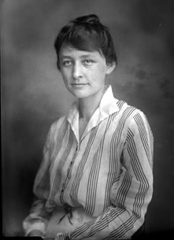
Early Life
Georgia Totto O’Keeffe was born on 15th November 1887 in Wisconsin, USA.
She was one of seven children, and her mother encouraged Georgia’s interest in art.
The landscape in Wisconsin was very important to Georgia, which became evident in her later work.
She studied at the Art Institute of Chicago and had her first gallery show in 1916.

Slide 3
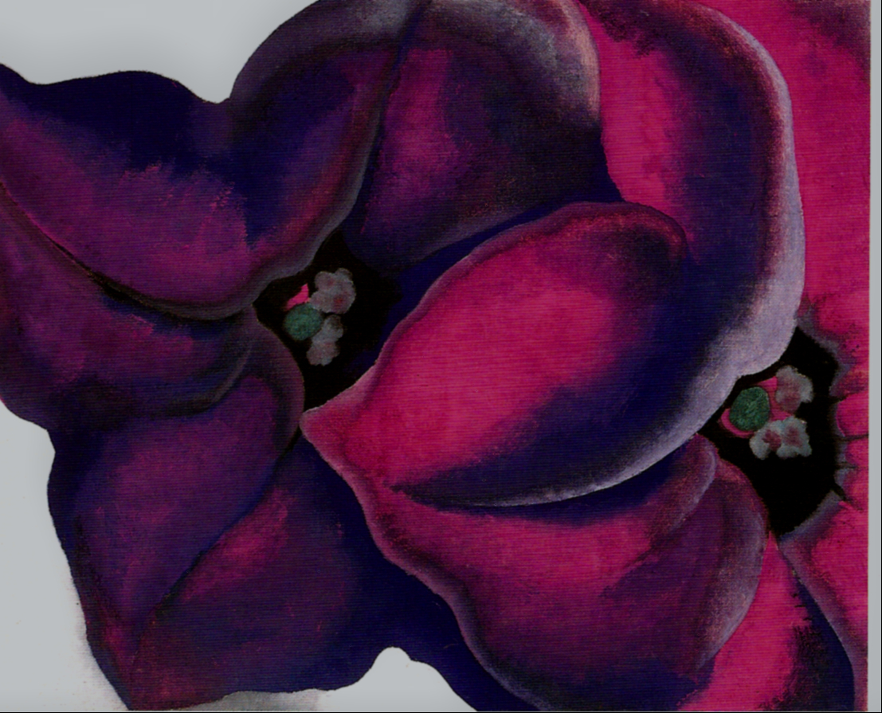
Flowers
Georgia began experimenting with painting close up views of flowers. She used oil paints in vibrant, bold colours.
Art Postcards 4 by koiart71 is licensed under CC BY 2.0

Slide 4
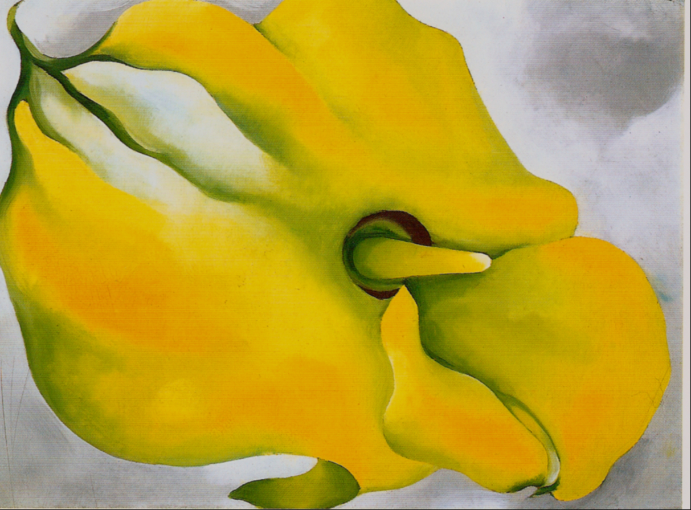
Yellow Calla
Georgia O'Keeffe Art Postcards 5 by koiart71 is licensed under CC BY 2.0

Slide 5
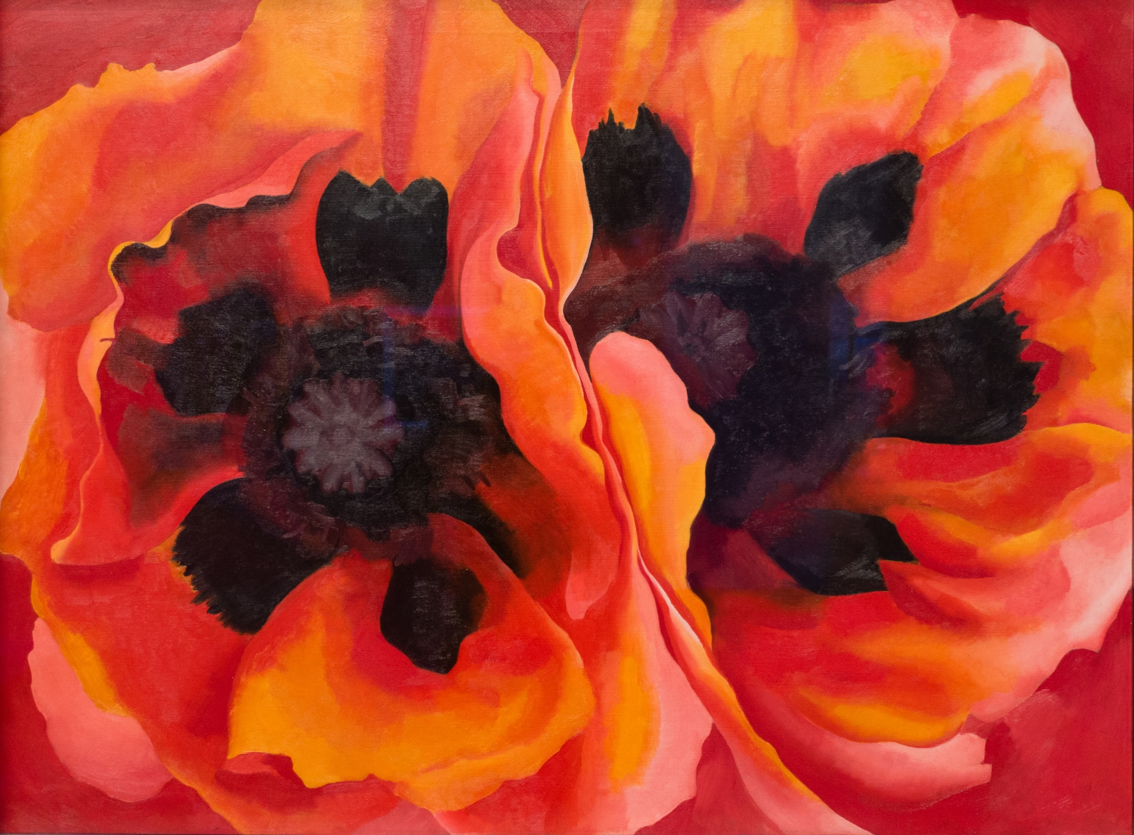
Oriental Poppies
Painting the flowers at such a close range makes the viewer see the object in a completely different way.
Georgia O'Keeffe, Oriental Poppies, 1927, Weisman by Sharon Mollerus is licensed under CC BY 2.0

Slide 6
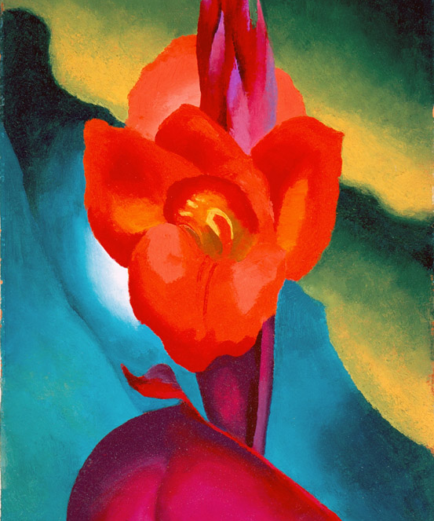
Inside Red Canna
The vibrancy of colour used and the simplified images of leaves and petals, resulted in dramatic and innovative paintings, exploring the idea of abstraction.
Georgia O'Keeffe Red Canna 1919 by High Museum of Art is licensed under CC BY 2.0

Slide 7
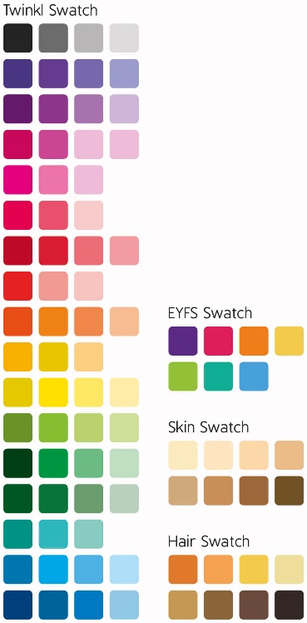
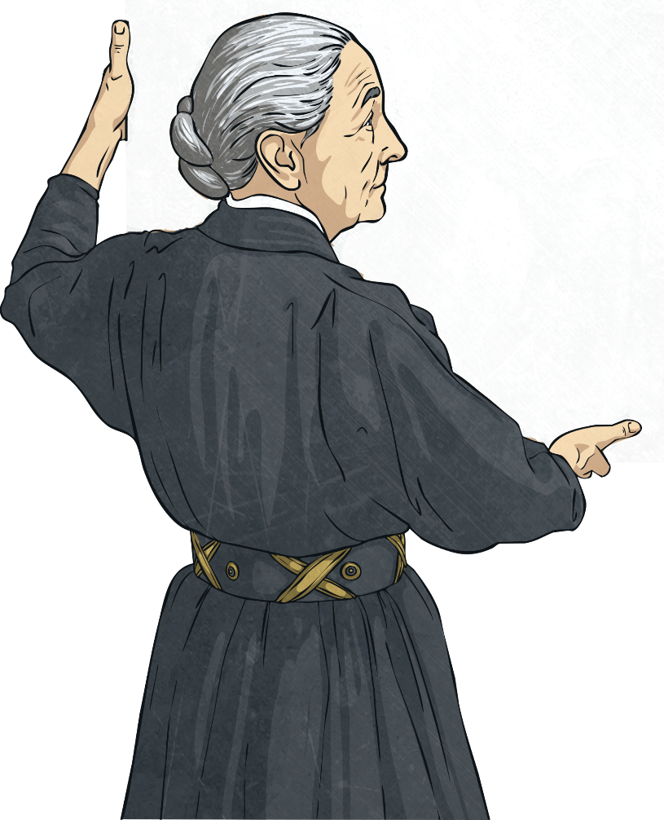
O’Keeffe’s Intention
"If I could paint the flower exactly as I see it no one
would see what I see because I would paint it small
like the flower is small. So I said to myself - I'll paint what I see - what the flower is to me but I'll paint it big
and they will be surprised into taking time to look
at it – I will make even busy New Yorkers take
time to see what I see of flowers."

Slide 8
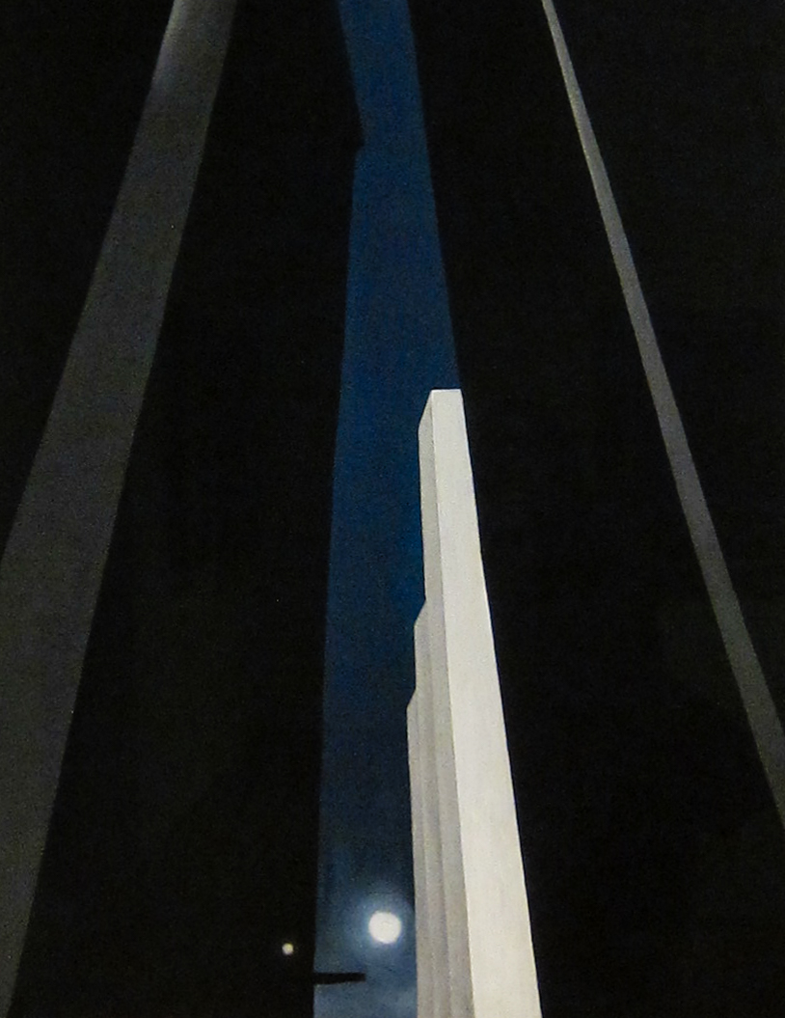
A Symbol of Modernity
O’Keefe looked around at her surroundings during her time living in New York City, and began painting the skyscrapers.
City Night, 1926 by Sharon Mollerus is licensed under CC BY 2.0
Photo courtesy of Sharon Mollerus (@flickr.com) - granted under creative commons licence – attribution

Slide 9
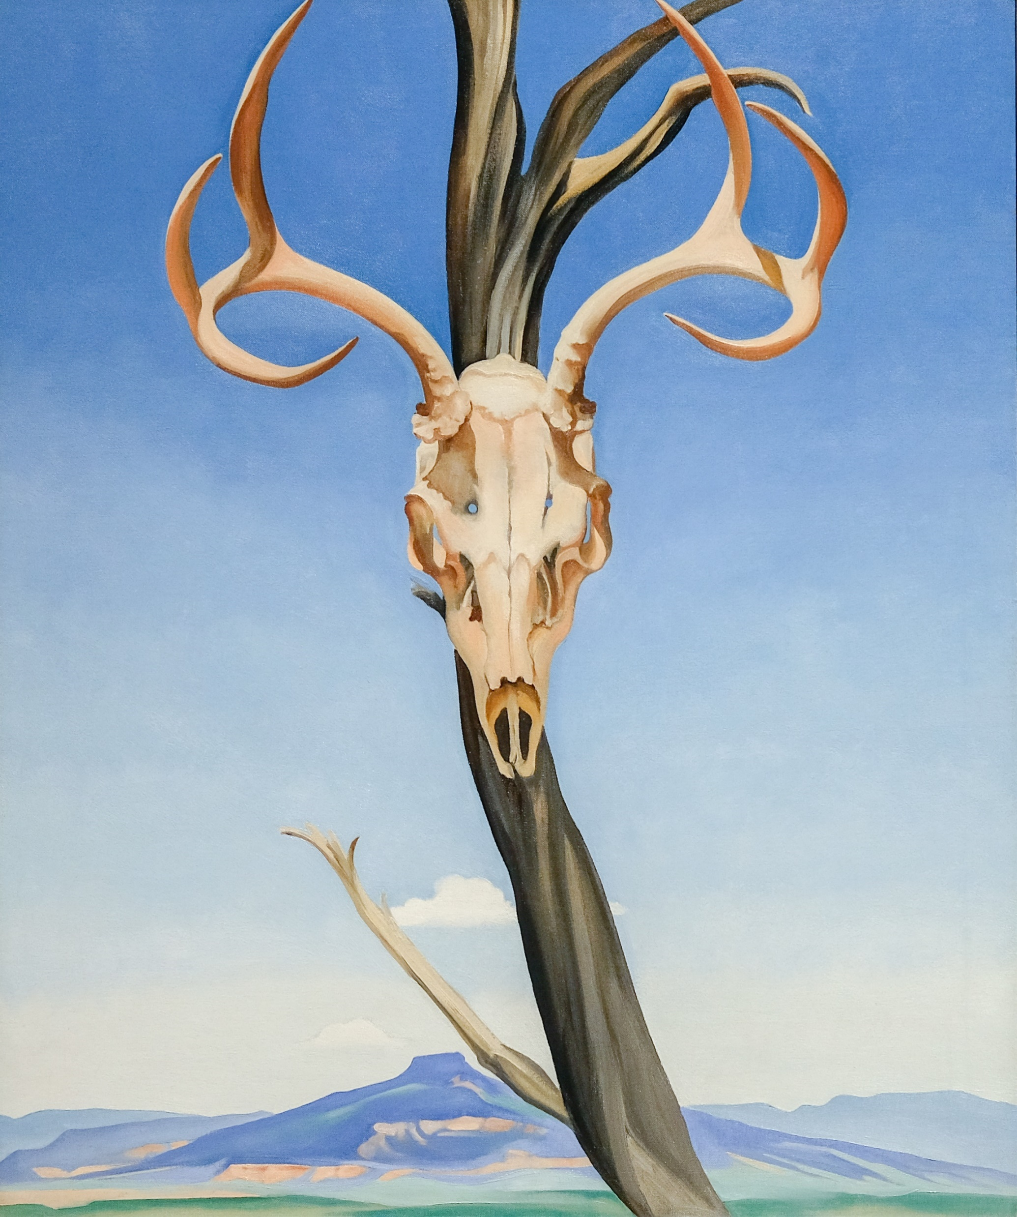
New Mexico
In 1929, O’Keeffe visited New Mexico and was amazed at the landscape; the incredible rock formations, the unusual light, the bones of animals dried out by the sun and the Navajo culture.
Georgia O'Keeffe, Deer's Skull with Pedernal, 1936 by Sharon Mollerus is licensed under CC BY 2.0

Slide 10
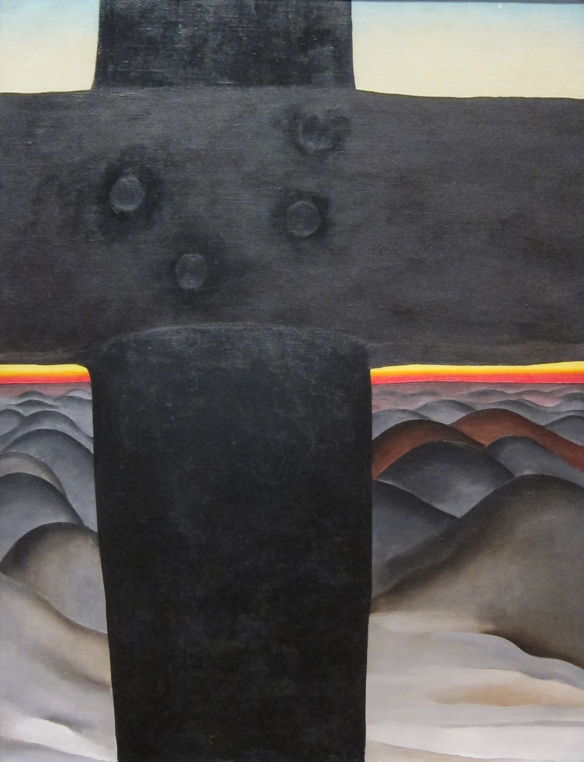
Black Cross
Photo courtesy of Sharon Mollerus (@flickr.com) - granted under creative commons licence – attribution
Black Cross, New Mexico, 1929 by Sharon Mollerus is licensed under CC BY 2.0

Slide 11
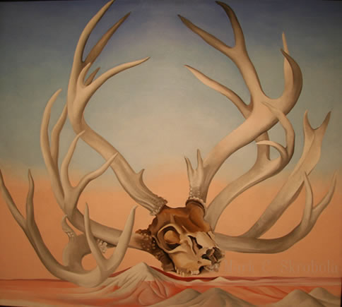
From the Faraway
Photo courtesy of missvancamp (@flickr.com) - granted under creative commons licence – attribution
From the Faraway, Nearby 1937, Georgia O'Keeffe by Mark Skrobola is licensed under CC BY 2.0

Slide 12
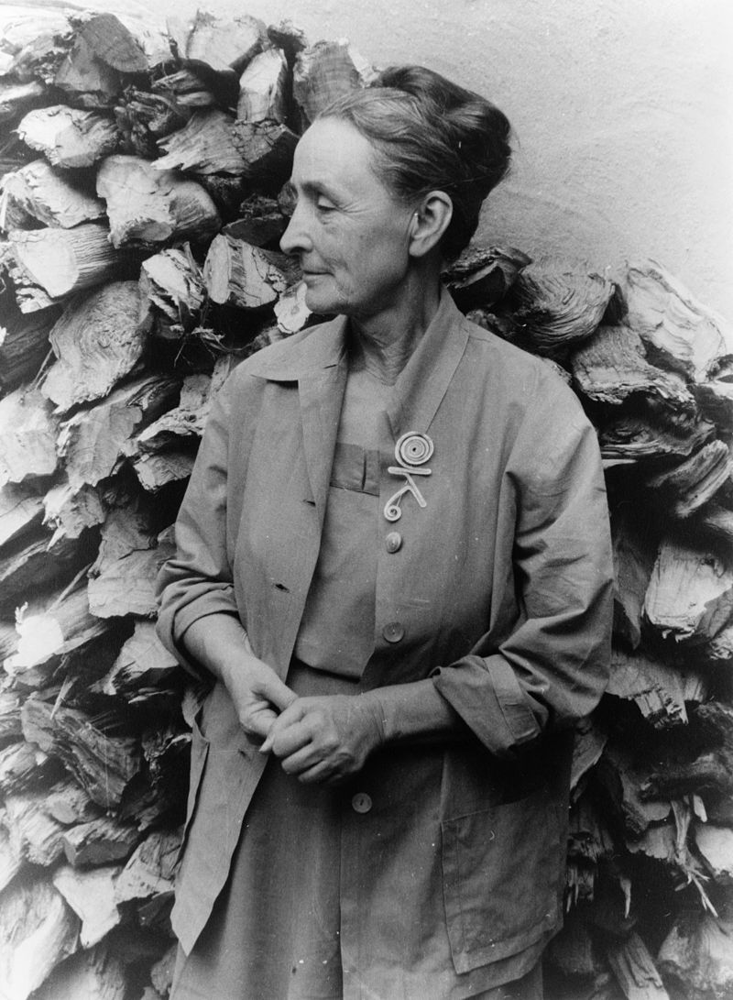
Later Life
Georgia O’Keeffe began to lose her eyesight and in 1972, she painted her last unassisted painting. In 1977, at 90 years old, she said,
“I can see what I want to paint. The
thing that makes you want to create
is still there.”

Slide 13
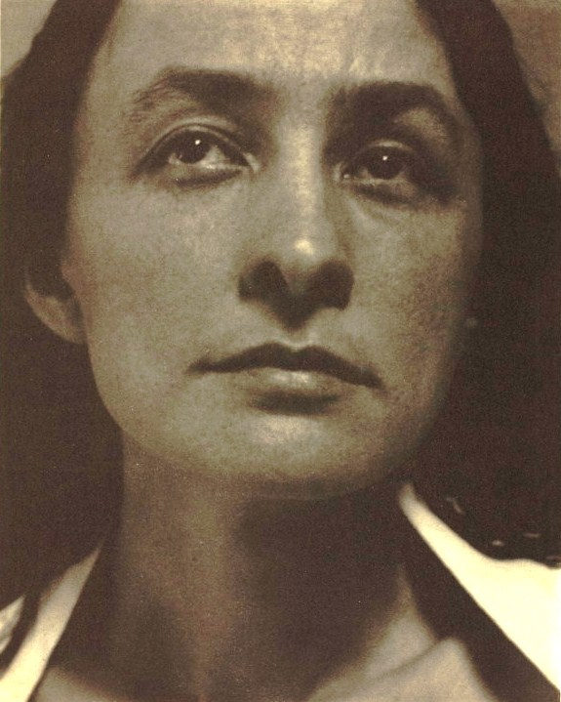
Legacy
Georgia O’Keeffe is recognised as being a pioneer of American modernism. She was highly praised for her art, which was unusual for a woman in a male dominated art world. She died on 6th March 1986 aged 98 years old.
She painted thousands of paintings in her lifetime. Many of them are on display at The Georgia O'Keeffe Museum, which opened in Santa Fe in 1997.

