Slide 1
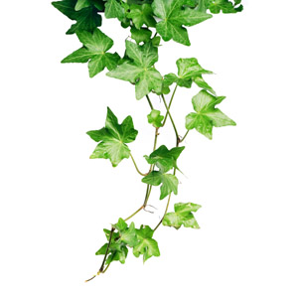
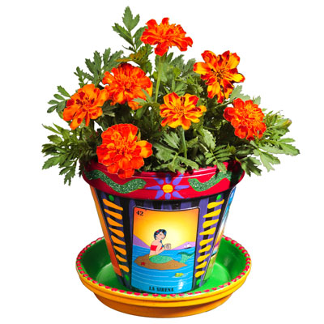
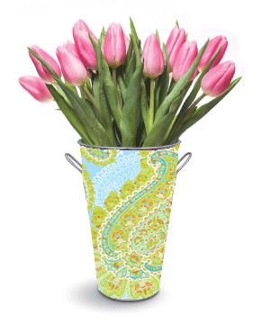

Plants:
Their parts and what they need to grow
Science!
www.TheStorySeed.com

Slide 2

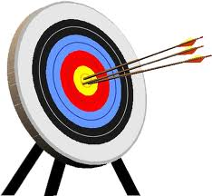
Science!
Objectives
To be able to label the parts of the plant.
To know what plants need for growth.

Slide 3
Science!
Can you label the different parts of the plant?

Slide 4
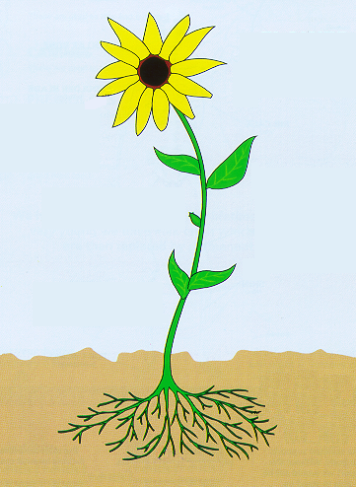
Science!
Let’s have a go at labelling this flower.
Petals
Stem
Bud
Leaves
Roots

Slide 5


Science!
Quick note!
1 petal | 2 petals
1 _____ | 2 _____
leaf
leaves

Slide 6
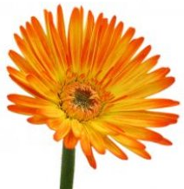
Science!
What plants need to
grow

Slide 7

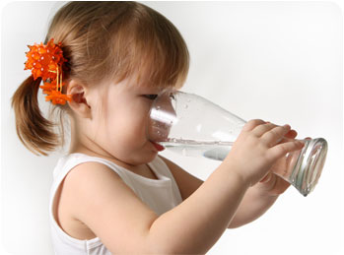
Science!
We need to eat food and drink water to grow.

Slide 8
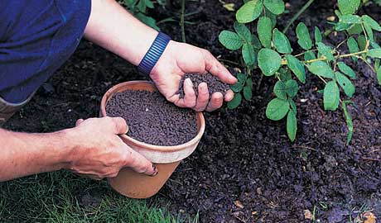
Science!
Plants need water too, just like us. But plants don’t eat anything. They make their own food.
?
So why do plants need fertiliser?

Slide 9
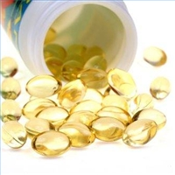
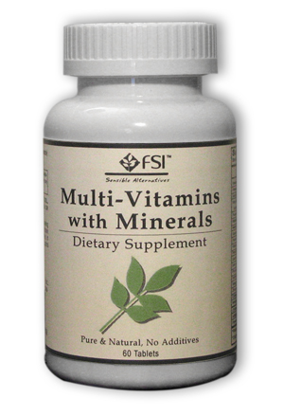
Science!
Fertilisers have nutrients in them. Plants use the nutrients to help them make their food.
Some of our parents, or maybe some of us, take supplements (extras) too, like vitamin tablets or cod liver oil.

Slide 10
Science!
Let’s look at the things plants need in order to grow properly.

Slide 11
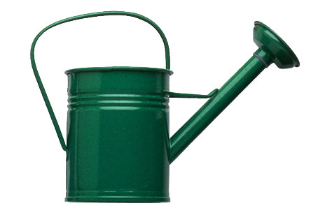

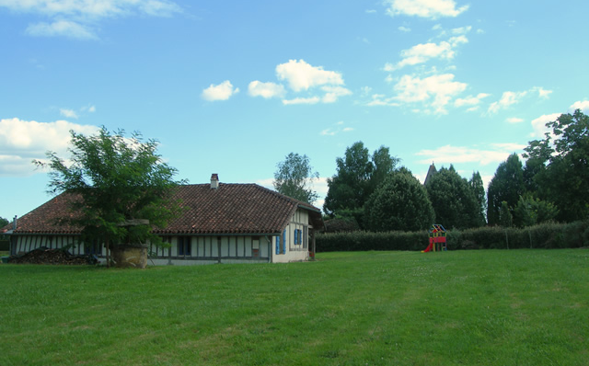

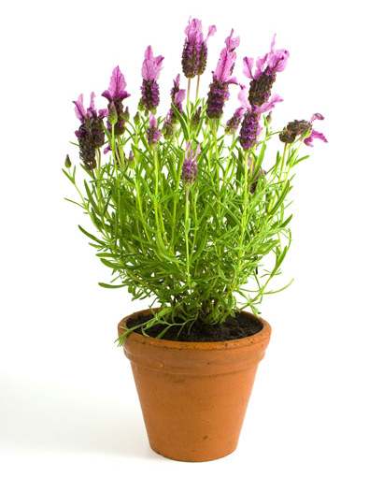
Science!
What can you
see here?
Water
Light
Warmth
Space
Nutrients

Slide 12

Science!
STOP
AND
THINK
So, can you remember what is it plants need in order to grow properly?
Now let’s find out why they need those things.

Slide 13
Science!
Light
Plants use light to make their own food. When plants make their food, this is called photosynthesis.
Photo means light.
Synthesis means making.
So, plants make food by using light.

Slide 14
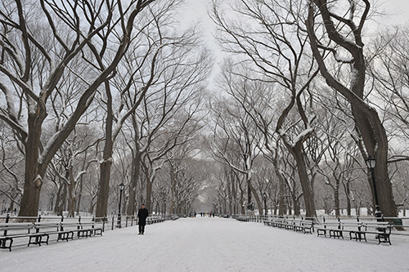
Science!
Warmth
Plants will die if the temperature is too low (if it’s too cold).
Think about what happens to plants and trees in the winter season.

Slide 15

Science!
Nutrients
Plants use nutrients to help them make their food. Fertiliser contains a lot of nutrients.
Different nutrients help the plant in different ways. Some help the roots grow. Some help the flowers grow.

Slide 16
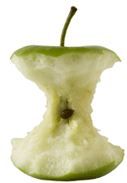
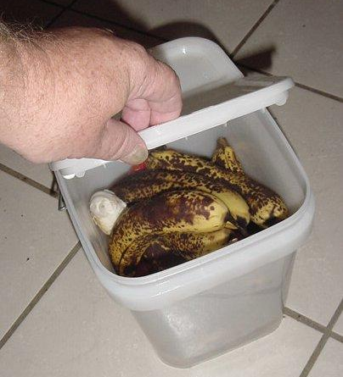
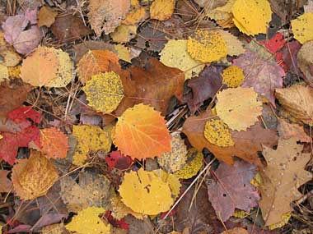

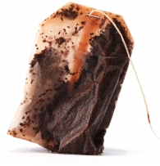
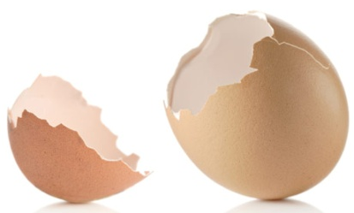
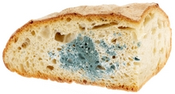
Science!
Who has a compost bin at home?
You can make your own fertiliser by leaving natural things to rot in your compost bin.

Slide 17

Science!
Water
Plants need water for photosynthesis.
Who can remember what photosynthesis is?

Slide 18
Science!
Water
The water also dissolves the nutrients so that they can be can be taken into the plant by the roots.

Slide 19
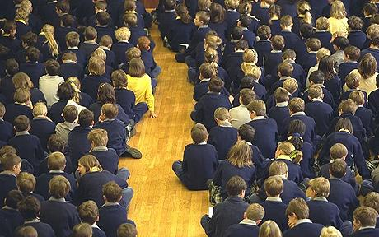
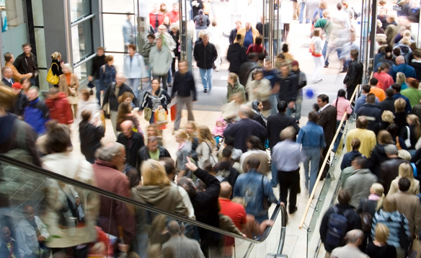
Science!
Space
Plants need space so that they have enough room to grow.
Who can think of examples of times when you were in a crowded place?
How did you feel?

Slide 20
Science!
STOP
AND
THINK
OK, can you list the 5 things plants need to grow?
Light
Warmth
Water
Nutrients
Space

Slide 21
Science!
End of slides!

