Slide 1



R4f. Can empathise with a character's motives and behaviours
Commissioned by The PiXL Club Ltd.
October 2017
This resource is strictly for the use of member schools for as long as they remain members of The PiXL Club. It may not be copied, sold nor transferred to a third party or used by the school after membership ceases. Until such time it may be freely used within the member school.
All opinions and contributions are those of the authors. The contents of this resource are not connected with nor endorsed by any other company, organisation or institution.
© Copyright The PiXL Club Limited, 2017

Slide 2
Teachers’ Notes
This therapy begins by explaining what is meant by the terms ‘empathy’ and ‘motives’. This is modelled using a simple, well-known tale.
Short extracts are then used to model how a character’s motives can be interpreted through their actions.
Pupils then have the opportunity to discuss and identify motives through the use of two extended extracts by established authors.
Throughout the therapy, pupils are encouraged to think about how else the character could have behaved, what they might have done or whether the actions were justified.

Slide 3
What is empathy?
Empathy is the ability to understand and share the feelings of another. Part of the challenge for an author is getting his readers to empathise with the characters.
For example, if a player looks totally exhausted after a tennis match, and we have felt similar exhaustion after exercise, we can empathise. It means we understand how they feel.
This can be confused with sympathy (noun) and sympathise (verb). Sympathy is when we feel sorry for, or pity, someone.

Slide 4
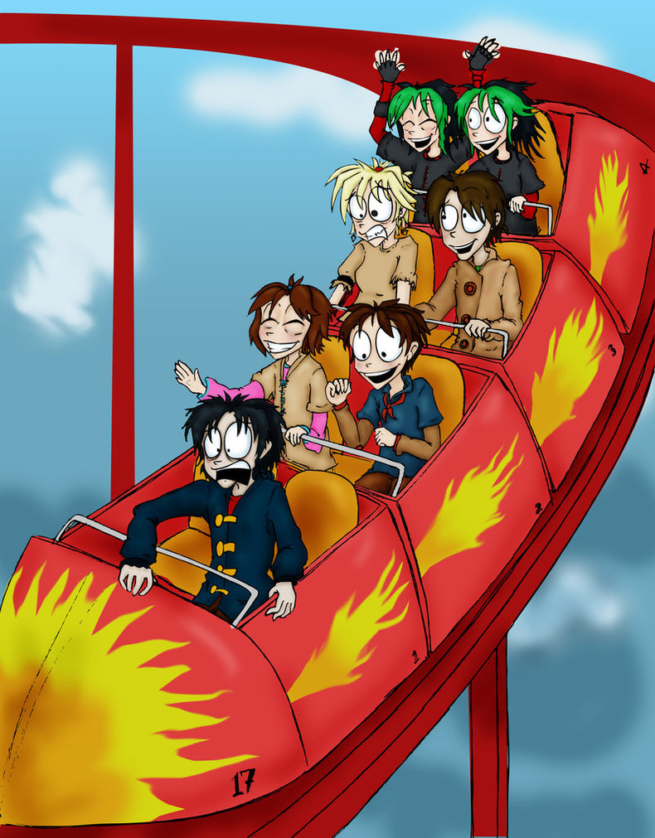
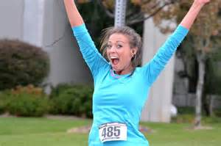
Your turn: how are these characters feeling? Tell your partner about a situation where you felt the same. Can you empathise with the person?

Slide 5
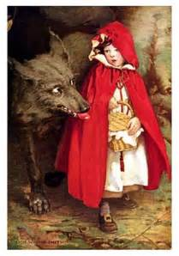
If we can empathise with characters, we can begin to understand their actions and motives for behaving in a certain way.
Your turn:
Can you summarise the story of ‘Little Red Riding Hood’?
Let’s look at the character of the wolf.
Action: to ask Red Riding Hood where she was going.
Motive: so he could race ahead to Granny’s and pretend to be Little Red Riding Hood.
Character trait: devious (sneaky).
If we could empathise with this action, we might think of a time when we have been devious to get what we want!
Can you think of a situation where you have been devious? (Obviously not as serious as the wolf!)

Slide 6
Your turn: think of one of the characters in the story then follow the instructions below:
a) Identify a key action.
b) Try to explain why they acted in that way (their motive).
c) Identify the character trait which this shows.
d) Can you think of a situation where you felt like that? Can you empathise?

Slide 7
Character Actions
Look at the extracts below. For each one, identify the ACTION and the MOTIVE for it.
Gemma noticed the teacher walking towards her, holding a big pile of books. Quickly, she rushed to the door and held it open for her.
ACTION: held the door open.
MOTIVE: to be helpful.
As she crossed the line, exhausted, Kim realised that she was only third. She folded her arms and marched off without congratulating the winner.
ACTION: folding arms and walking off.
MOTIVE: upset not to have won.

Slide 8
Character Actions
Look at the extracts below. For each one, identify the ACTION and the MOTIVE for it.
Claire sighed as she tried for the fifth time to measure the angle accurately. Noticing her sad face, Sam leant across and showed her how to line up the protractor correctly.
ACTION: showed Claire how to use the protractor.
MOTIVE: to be helpful.
“I’ve had enough of this. My lion looks rubbish!” shouted Tom, in the middle of the art lesson. Suddenly, he threw down his pencil and screwed up his paper.
ACTION: throwing the pencil and screwing up the paper.
MOTIVE: because he was unhappy with his drawing.

Slide 9
Discussion
Read this extract and, for each character, identify one action. Can you identify a MOTIVE for it?
He said, in a terrible voice, ‘Hepzibah, Hepzibah, Hepzibah! So she’s got to you too, has she? Bewitched you with her lying tales and slippery ways as well as my poor sister!’
He pushed roughly past her and out of the room. He roared down the passage, ‘Louise, LOUISA…’
He had knocked over the water jug when he got up from the table. Carrie tried to mop up the mess with the edge of the tablecloth and put a mat under the worst of it to stop the damp marking the table, but her hands seemed all thumbs and she couldn’t stop crying. It had all gone wrong somehow; she didn’t know why, but it had. Mr Evans was angry and he shouldn’t have been, she had tried so hard to explain…
Nick said, beside her, ‘What on earth have you done?’
‘T’wasn’t me’, she sobbed. ‘It was him. He knocked the jug over.’
‘I didn’t mean that, you half-witted dope! Just listen to him. Did you start him off?’
He was shouting at Auntie Lou in the kitchen. ‘….told you what was going on, didn’t I? Told you she’d got her claws in, but you wouldn’t have it.’
From ‘Carrie’s War’ by Nina Bawden

Slide 10
Let’s look at an example question
Why did Mr Evans push past Carrie?
He said, in a terrible voice, ‘Hepzibah, Hepzibah, Hepzibah! So she’s got to you too, has she? Bewitched you with her lying tales and slippery ways as well as my poor sister!’
He pushed roughly past her and out of the room. He roared down the passage, ‘Louise, LOUISA…’
He had knocked over the water jug when he got up from the table. Carrie tried to mop up the mess with the edge of the tablecloth and put a mat under the worst of it to stop the damp marking the table, but her hands seemed all thumbs and she couldn’t stop crying. It had all gone wrong somehow; she didn’t know why, but it had. Mr Evans was angry and he shouldn’t have been, she had tried so hard to explain…
Nick said, beside her, ‘What on earth have you done?’
‘T’wasn’t me’, she sobbed. ‘It was him. He knocked the jug over.’
‘I didn’t mean that, you half -witted dope! Just listen to him. Did you start him off?’
He was shouting at Auntie Lou in the kitchen. ‘….told you what was going on, didn’t I? Told you she’d got her claws in, but you wouldn’t have it.’
From ‘Carrie’s War’ by Nina Bawden
He is clearly cross about ‘Hepzibah’ telling Carrie tales. As soon as he had left the room, he was calling to his wife and, later in the extract, he seemed to be blaming his wife.
So, my answer would be:
He pushed past Carrie because he was angry and wanted to go and speak to his wife.

Slide 11
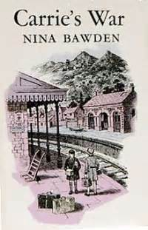
Let’s look at an example question
Why did Mr Evans push past Carrie?
Was this the right way for him to behave? Why/why not?
If you were in this situation, what would you have done?
Have you ever felt angry and determined to speak to someone? Can you empathise with Mr Evans?

Slide 12
Your turn: answer these questions about the characters’ motives. Try to give reasons for your answers.
He said, in a terrible voice, ‘Hepzibah, Hepzibah, Hepzibah! So she’s got to you too, has she? Bewitched you with her lying tales and slippery ways as well as my poor sister!’
He pushed roughly past her and out of the room. He roared down the passage, ‘Louise, LOUISA…’
He had knocked over the water jug when he got up from the table. Carrie tried to mop up the mess with the edge of the tablecloth and put a mat under the worst of it to stop the damp marking the table, but her hands seemed all thumbs and she couldn’t stop crying. It had all gone wrong somehow; she didn’t know why, but it had. Mr Evans was angry and he shouldn’t have been, she had tried so hard to explain…
Nick said, beside her, ‘What on earth have you done?’
‘T’wasn’t me’, she sobbed. ‘It was him. He knocked the jug over.’
‘I didn’t mean that, you half -witted dope! Just listen to him. Did you start him off?’
He was shouting at Auntie Lou in the kitchen. ‘….told you what was going on, didn’t I? Told you she’d got her claws in, but you wouldn’t have it.’
From ‘Carrie’s War’ by Nina Bawden
Why do you think Carrie was trying to clear up the mess?
How do you think Nick is feeling when he says to Carrie, ’What on earth have you done?’
Why do you think Carrie couldn’t stop crying?

Slide 13
How did you do? Here are some possible answers:
Why do you think Carrie was trying to clear up the mess?
Firstly, to stop it becoming worse. Also, because she didn’t want Mr Evans to be any more angry, so she was trying to make the situation better.
How do you think Nick is feeling when he says to Carrie, ’What on earth have you done?’
He seems to be frustrated with Carrie – almost as if he is blaming her. The words ‘on earth’ exaggerate his feelings as if she has done something really wrong.
Why do you think Carrie couldn’t stop crying?
Because she was so upset about the situation. From the words ‘Mr Evans was angry and he shouldn’t have been, she had tried so hard to explain …’ it seems that Carrie had been trying to explain something and she couldn’t understand why Mr Evans reacted as he did. Her tears are a mixture of fear and frustration.

Slide 14
Your turn: read this extract then answer the questions on the next slide.
‘Do I look stupid?’ snarled Uncle Vernon, a bit of fried egg dangling from his bushy moustache. ‘I know what’ll happen if that owl’s let out.’
He exchanged dark looks with his wife, Petunia.
Harry tried to argue back but his words were drowned by a long, loud belch from the Dursley’s son, Dudley.
‘I want more bacon.’
‘There’s more in the frying pan, sweetums,’ said Aunt Petunia, turning misty eyes on her massive son. ‘We must feed you up while we’ve got the chance… I don’t like the sound of that school food…’
‘Nonsense, Petunia, I never went hungry when I was at Smeltings,’ said Uncle Vernon heartily. ‘Dudley gets enough, don’t you, son?’
Dudley, who was so large his bottom drooped over either side of the kitchen chair, grinned and turned to Harry.
‘Pass the frying pan.’
‘You’ve forgotten the magic word,’ said Harry irritably.
The effect of this simple sentence on the rest of the family was incredible: Dudley gasped and fell off his chair with a crash that shook the whole kitchen; Mrs Dursley gave a small scream and clapped her hands to her mouth; Mr Dursley jumped to his feet, veins throbbing in his temples.
From ‘Harry Potter and the Chamber of Secrets’ by J.K.Rowling

Slide 15
‘Do I look stupid?’ snarled Uncle Vernon, a bit of fried egg dangling from his bushy moustache. ‘I know what’ll happen if that owl’s let out.’
He exchanged dark looks with his wife, Petunia.
Harry tried to argue back but his words were drowned by a long, loud belch from the Dursley’s son, Dudley.
‘I want more bacon.’
‘There’s more in the frying pan, sweetums,’ said Aunt Petunia, turning misty eyes on her massive son. ‘We must feed you up while we’ve got the chance… I don’t like the sound of that school food…’
‘Nonsense, Petunia, I never went hungry when I was at Smeltings,’ said Uncle Vernon heartily. ‘Dudley gets enough, don’t you, son?’
Dudley, who was so large his bottom drooped over either side of the kitchen chair, grinned and turned to Harry.
‘Pass the frying pan.’
‘You’ve forgotten the magic word,’ said Harry irritably.
The effect of this simple sentence on the rest of the family was incredible: Dudley gasped and fell off his chair with a crash that shook the whole kitchen; Mrs Dursley gave a small scream and clapped her hands to her mouth; Mr Dursley jumped to his feet, veins throbbing in his temples.
From ‘Harry Potter and the Chamber of Secrets’ by J.K.Rowling
Why do you think Harry was irritable?
Why did Mr Dursley ‘exchange dark looks’ with his wife?
Why do you think Mr Dursley jumped to his feet after Harry spoke?

Slide 16
How did you do? Here are some possible answers:
Why do you think Harry was irritable?
Because the family were all being rude to him (for example, Uncle Vernon ‘snarled’ at him). Also, Uncle Vernon wouldn’t let Harry’s owl out.
Because he was suspicious of the owl and worried what would happen if he let it out. By looking at his wife, he was sending her the message that he wasn’t very happy about the situation.
Why did Mr Dursley ‘exchange dark looks’ with his wife?
Why do you think Mr Dursley jumped to his feet after Harry spoke?
Because he was angry. He felt Harry was trying to annoy them by mentioning ‘magic’ and he wanted to do something about it. The fact that his temples were ‘throbbing’ also suggests that he is angry.

Slide 17
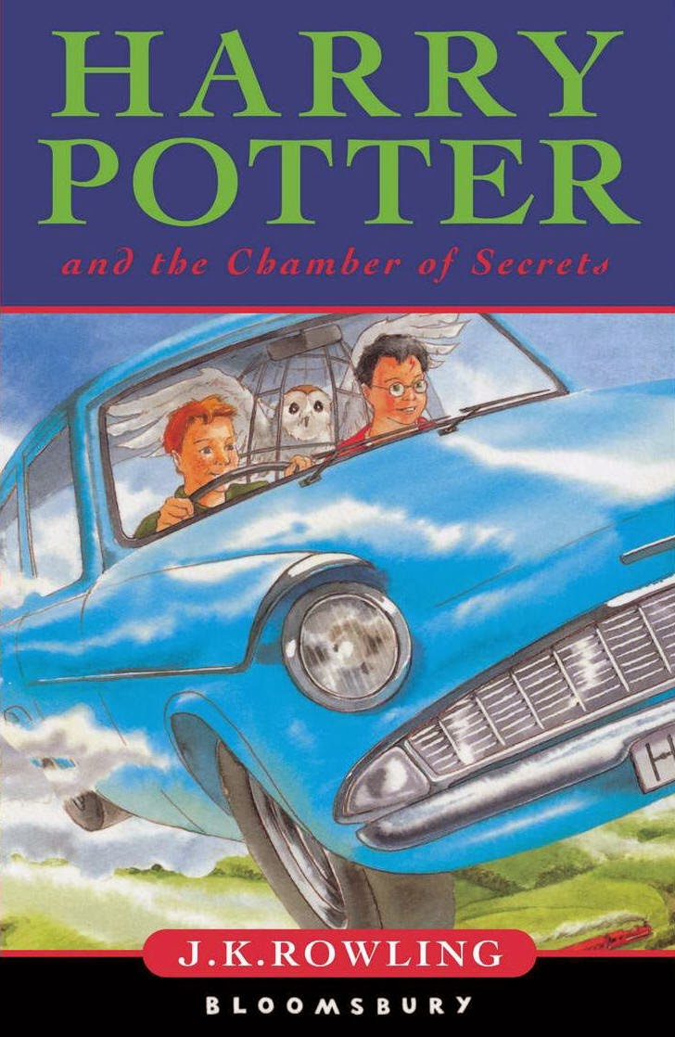
Can you empathise with these characters?
Was it right for Harry to try to annoy (wind up) the family by mentioning magic?
If you were in this situation, what would you have done?
Mr Dursley often feels that Harry is ‘up to something’ and he is suspicious of Harry’s actions? Have you ever felt like this? Give an example.

Slide 18
So, when we are reading narratives, empathising with the character helps us to understand their actions. By working out the motive for their actions, we can understand their character much better.

