Slide 1



B2R3a. Can identify, select and highlight key words in a sentence to answer recall questions.
Commissioned by The PiXL Club Ltd.
Example 2017
This resource is strictly for the use of member schools for as long as they remain members of The PiXL Club. It may not be copied, sold nor transferred to a third party or used by the school after membership ceases. Until such time it may be freely used within the member school.
All opinions and contributions are those of the authors. The contents of this resource are not connected with nor endorsed by any other company, organisation or institution.
© Copyright The PiXL Club Limited, 2017

Slide 2
Teachers’ Notes
In this therapy, the focus is on modelling the use of key words to help pupils answer questions about a text.
It begins by modelling how to identify the key words in the question. Then it moves on to using these to locate the relevant information in the text.
Throughout the lesson, there are opportunities for pupils to practise these skills independently.

Slide 3
To help us to understand and answer questions about a text, it is important that we can pick out key words.
For example: what are the most important words to understand in this question?
What sort of food does a penguin eat?
What sort of food does a penguin eat?
The key words in this question are ‘food’ and ‘penguin eat’. The other words link these together, but they wouldn’t help me to answer the question.

Slide 4
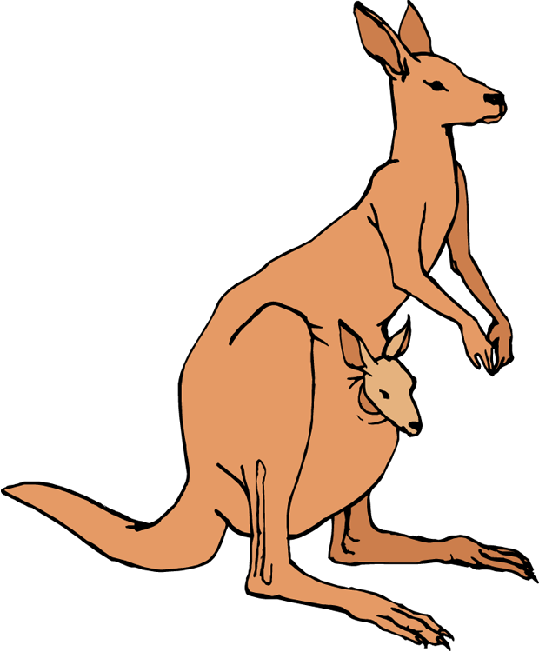
Your turn: can you pick out the key words in these questions?
What colour are kangaroos?
What is the capital city of Australia?
What is the highest mountain in the world?
Can you give a reason why camels have long eye lashes?

Slide 5
How did you do?
What colour are kangaroos?
What is the capital city of Australia?
What is the highest mountain in the world?
Can you give a reason why camels have long eye lashes?

Slide 6
Why is it important to be able to identify key words?
If we can identify the key words in a question, we are more likely to be clear on what we are being asked. It will also help us to find the answer in the text.
Penguins are excellent swimmers. They have special flippers to help them swim. Penguins can swim up to speeds of 15 miles per hour. They can stay underwater for up to 20 minutes at a time. Penguins’ black and white colouring gives them camouflage while they are swimming.
Read this text then we will model how to find answers using key words.

Slide 7
What speed can penguins swim at?
Firstly, highlight the key words in the question.
Penguins are excellent swimmers. They have special flippers to help them swim. Penguins can swim up to speeds of 15 miles per hour. They can stay underwater for up to 20 minutes at a time. Penguins’ black and white colouring gives them camouflage while they are swimming.
Now I scan the text for my key words.
Once I find the key words, I will read the full sentence and, hopefully, find the answer.
So, the answer is: up to 15 miles per hour (we don’t need a full sentence here).

Slide 8
Your turn: use key words to help you to answer these questions about the text.
Kangaroos are found in the wild in Australia. There are four different types of kangaroo. An interesting fact about kangaroos is they can’t walk backwards! However, they can jump up to three times their own height. They can also swim.
Baby kangaroos are called ‘joeys’ and they are carried around in their mother’s pouch. They usually live to the age of six years old.
How many types of kangaroo are there?
What are baby kangaroos called?
What age do kangaroos usually live to?

Slide 9
Your turn: use key words to help you to answer these questions about the text.
The T-Rex is known as the ‘King of the Dinosaurs’. It was a vicious meat-eating creature. It weighed about 7.5 tons. It had huge, powerful back legs to carry its massive body. It also had a long, thick tail to help with balance.
Scientists think that the T-Rex probably didn’t run. One reason is because of how big it was. Another is that, if it fell over, it probably wouldn’t have been able to get back up again!
Write down two adjectives used to describe the legs of a T-Rex.
Why did it have a thick, long tail?
Which word tells us that the body was very big?

Slide 10
Your turn: use key words to help you to answer these questions about the text.
As they entered the room, they noticed Grendor standing over a large, black pot. He was stirring something which was boiling loudly. On the shelf above him was an assortment of jars. Each one had a label on it. Jake was able to read, ‘Toad Warts’ and ‘Lizard Tails’. His stomach turned over. Grendor turned his huge, silver eyes towards them and smiled. As he did so, a golden serpent slithered across the wooden floor.
What was in the jars?
Which adjectives are used to describe Grendor’s eyes?
How did the serpent move across the floor?

Slide 11
So, when you are trying to answer questions about a text, make sure you do the following:
Read the text carefully first.
Read the question carefully.
Underline or highlight the key words in the question.
Scan the text for these key words.
Read the text around them.
Find the answer.
Always read the question again to check that you have answered it correctly.

