Slide 1


.
Reading
Y5 R5a. Explains clearly how vocabulary choices affect meaning in a range of text types
Commissioned by The PiXL Club Ltd.
November 2019
This resource is strictly for the use of member schools for as long as they remain members of The PiXL Club. It may not be copied, sold nor transferred to a third party or used by the school after membership ceases. Until such time it may be freely used within the member school.
All opinions and contributions are those of the authors. The contents of this resource are not connected with nor endorsed by any other company, organisation or institution.
PiXL Club Ltd endeavour to trace and contact copyright owners. If there are any inadvertent omissions or errors in the acknowledgements or usage, this is unintended and PiXL will remedy these on written notification.
© Copyright The PiXL Club Limited, 2019

Slide 2
Teachers’ Notes
The PiXL therapies can be taught to a whole class or a target group. Each therapy is editable so that it can be adapted or extended.
This is followed by a vocabulary task, which uses the PiXL 5-phase approach to teach key vocabulary. Further resources to develop vocabulary can be found in the Whole School area under the PiXL Unlock strategy.
Each therapy adopts the ‘Teach, model and apply’ process with plenty of opportunities for pupils to demonstrate the taught skill.
A range of question types is included to promote pupils’ developing security by testing the same skill in different ways.

Slide 3

Shades of meaning
Put these words in order. Explain how you have ordered them.
disappointed
miserable
Vocabulary Task
gloomy
sad
dejected

Slide 4
Vocabulary choices
Writers take great care when choosing their words. As readers, we need to be able to understand those choices in order to enjoy the full effect of their writing. Sometimes, this might take a little thinking …

Slide 5
Text types
Many of those vocabulary choices are influenced by the text type:
Factual texts will probably use more accurate or technical language.
Fiction will often have more descriptive or imaginative language.
Persuasive writing might use exaggeration to make a point.

Slide 6
Different words, similar meaning
Look at the different words that have been used instead of bad in these texts:
Factual
To deter predators, skunks spray a liquid that has a particularly unpleasant odour.
Fiction
When they opened the cellar door, they recoiled at the foul waft of decay that assaulted their senses.
Persuasive
Cutting down refuse collections will cause a disgusting stench.

Slide 7
Different words, similar meaning
Factual
Unpleasant is a straightforward, undramatic way to describe a bad smell.
Fiction
Foul is quite a powerful word that also hints at something nasty.
Persuasive
Disgusting is a very strong word that you could even say is an exaggeration to make a point.

Slide 8
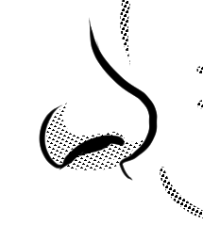
Another example
Did you notice the other example from the previous slide?
factual – odour
fiction – waft
persuasive – stench
They all refer to a smell. Odour is a straightforward, unemotional word. Waft suggests movement as well as a smell so it contributes to the action. Stench is another powerful word to help make the point more forcefully.

Slide 9
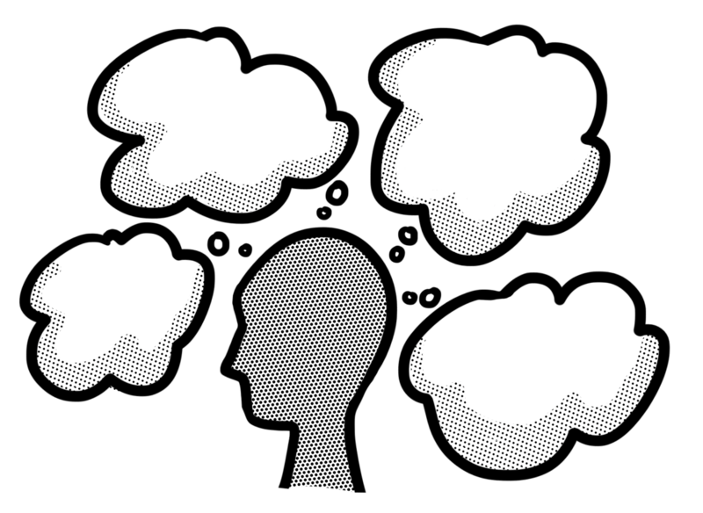
Explanations
Once we have identified an interesting choice of vocabulary, we need to explain what we think the reasons are for that choice. On the previous slide, we began to look at the reasons for different vocabulary choices for the word smell. Let’s look at some more…

Slide 10

Explanations
Can you explain the vocabulary choices in italics in these sentences? See the next slide for our suggestions.
Once the government had decided to order an evacuation,
people were expected to obey.
To get the best performance out of your new printer, we strongly recommend that you only use our own-brand printer ink.

Slide 11

Explanations
Both order and recommend compel an action. Order is more formal and can suggest that it comes from someone in authority. Recommend is often used in persuasive writing, such as advertising, to make you feel that you really have to do something, even to the point of suggesting that you would be unwise not to.

Slide 12
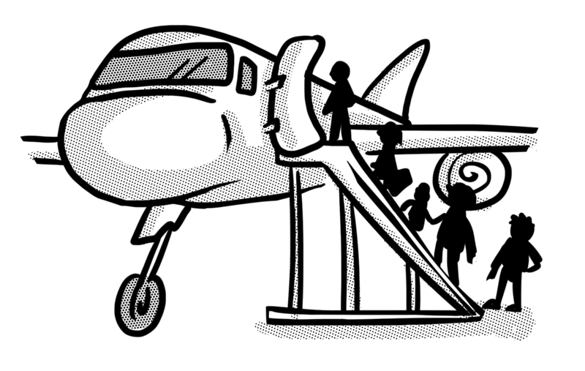
Explanations
Let’s look at another example. Can you explain the vocabulary choices in italics in these sentences and say what text type you think they are from? See the next slide for our suggestions.
Within ten minutes of take-off, commercial aeroplanes
are expected to ascend to their cruising altitude.
Flywoman used her amazing insect feet to scale the sides of towering skyscrapers.

Slide 13


Explanations
Both ascend and scale mean climb. Ascend is a more technical word which suggests this sentence is from an information text. Scale is quite a dramatic word and is more likely to be used in a fiction text.

Slide 14

Author intent
Sometimes, the author uses a particular word or phrase because it fits in well with the theme of the writing.
Once they got back to their den, the White Peak Pack howled with laughter at having played such a good trick on the sheepdogs in the village.

Slide 15
Author intent
People often use the phrase howled with laughter although there are many other ways of describing it. The author has used howled because it also fits nicely with the fact that the characters in this text are wolves. Wolves famously howl to communicate with each other.

Slide 16
Your turn
Read these two sentences, then explain how the vocabulary choices in italics have affected the meaning.
Before she knew what was happening, the naughty dog snatched the string of sausages and sprinted off down the road.
Very gently, he eased the book out of his sleeping son’s hands and tucked his blanket around him.

Slide 17
How did you do?
Both snatched and eased have been used to show that something was being removed. Snatched suggests that this was quick and probably not a good thing to have done. Eased suggests that it was done slowly and gently, in a caring way.

Slide 18

Your turn
Have another go. Read these two sentences, then explain how the vocabulary choices in italics have affected the meaning.
I would be very grateful for your assistance with this matter.
“Could you lend me a hand with these heavy books, please?”
said Mum.

Slide 19

How did you do?
Both assistance and lend me a hand mean that someone is being asked to help. Assistance is a more formal word and it feels like this was part of a formal letter. Lend me a hand is a more informal, conversational vocabulary choice and it seems like this sentence has been taken from a story.

Slide 20

Your turn
Have another go. How does the word droned add to the atmosphere of this text?
As the grown-ups droned on and on, he lay back on the rug and closed his eyes, lulled by the gentle hum of the insects.

Slide 21
How did you do?
Words like lull and hum give the text a sleepy atmosphere. Drone adds to this by turning the grown-ups’ voices into a vague, dull noise, rather like the buzzing of bees.

Slide 22
Review
Different vocabulary choices can affect the meaning of texts.
Vocabulary choices are often influenced by the text type.
The formality or informality of the text will influence the vocabulary choices.
Words might also be chosen to reflect the theme or atmosphere of a text.
Try to think why one word has been used instead of
another with a similar meaning.

