Slide 1



R5b. Recognises a range of descriptive devices including figurative language.
Commissioned by The PiXL Club Ltd.
October 2017
This resource is strictly for the use of member schools for as long as they remain members of The PiXL Club. It may not be copied, sold nor transferred to a third party or used by the school after membership ceases. Until such time it may be freely used within the member school.
All opinions and contributions are those of the authors. The contents of this resource are not connected with nor endorsed by any other company, organisation or institution.
© Copyright The PiXL Club Limited, 2017

Slide 2
Teachers’ Notes
This therapy begins by focusing on the descriptive devices of expanded noun phrases, adverbials and prepositional phrases. For each device, there is an explanation and exemplification of its use.
This is followed by the use of figurative language with similes, metaphors, personification and alliteration being modelled.
Throughout the therapy, pupils are given the opportunity to discuss the effectiveness of selected phrases and devices.
To further reinforce their understanding of these devices, pupils could take extracts from their reading book and see how many examples they could find.

Slide 3
Descriptive devices in a text could be:
expanded noun phrases
adverbial phrases
prepositional phrases
Figurative language could include:
similes
metaphors
alliteration
personification

Slide 4
When writing descriptively, we need a range of devices to create interesting texts for the reader.
noun phrases
the dark woods
determiner + adjective + noun
expanded noun phrases
the dark, gloomy woods in the distance
determiner + two adjectives + noun + prepositional phrase
Expanded noun phrases add more information about the noun using more than just one adjective and a determiner.

Slide 5
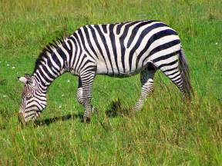
Imagine we wanted to describe this zebra. We can build it up as follows:
the zebra
the striped zebra
(noun phrase)
Take care – there should be no verbs!
the beautiful, striped zebra
(expanded noun phrase)
the beautiful, striped zebra in the sunshine
(expanded noun phrase)

Slide 6
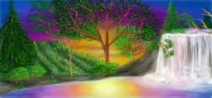
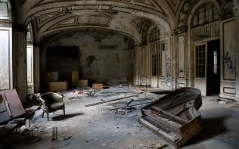
Your turn: choose some of the nouns in these pictures and build up your own expanded noun phrases.

Slide 7
By using expanded noun phrases, the writer allows the reader to picture the things which are being described.
As the beautiful sunshine poured onto the crystal-clear lake, stunning reflections of the nearby, silver trees could be seen rippling on the surface. Every so often, fantastic rainbow fish leapt from the icy water and their multi-coloured scales seemed to wink as they caught the diamond light.
Your turn: can you identify the expanded noun phrases in these texts?
Are they effective? Give reasons for your answer.
In the shadowed corner, a dusty, old piano sat as if it had been abandoned. The broken, splintered legs lay on the floor, surrounded by various shards of wood and rotten furniture. If you listened carefully, the curious sound of small creatures scuttling under the floorboards could be heard.

Slide 8
How did you do?
As the beautiful sunshine poured onto the crystal-clear lake, stunning reflections of the nearby, silver trees could be seen rippling on the surface. Every so often, fantastic rainbow fish leapt from the icy water and their multi-coloured scales seemed to wink as they caught the diamond light.
In the shadowed corner, a dusty, old piano sat as if it had been abandoned. The broken, splintered legs lay on the floor, surrounded by various shards of wood and rotten furniture. If you listened carefully, the curious sound of small creatures scuttling under the floorboards could be heard.

Slide 9
ADVERBIALS are words, phrases or clauses that tell us more about the verb. They can add description in the following ways:
adverbials
HOW
WHEN
WHERE
WHY
Adverbials which tell us WHERE something was done can also be known as PREPOSITIONS or PREPOSITIONAL PHRASES e.g. ‘Next to her, …’

Slide 10
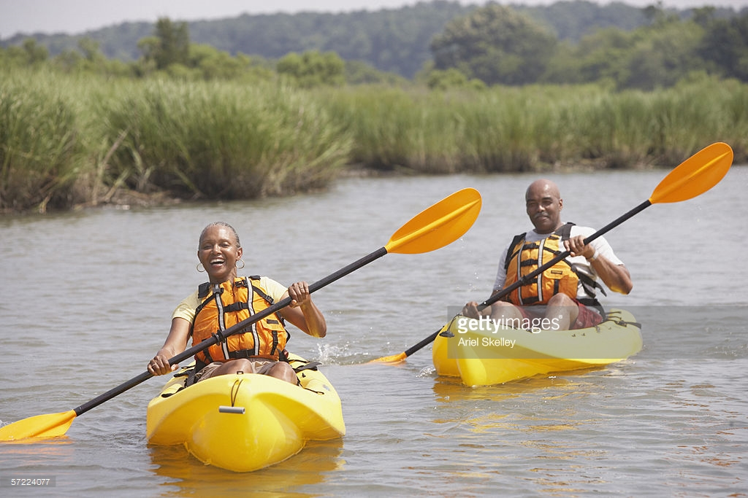
Adverbials
An adverbial can tell us HOW the verb was done.
Energetically, the couple kayaked.
An adverbial can tell us WHY the verb was done.
Because they enjoyed being outside, the couple kayaked.

Slide 11
Adverbials
An adverbial can tell us WHERE the verb was done.
The couple kayaked on the river.
An adverbial can tell us WHEN the verb was done.
Yesterday, the couple went kayaking.

Slide 12
Your turn: read the following text and identify the adverbial phrases which describe how, when, where or why the verb was performed.
As she rounded the final bend, Kate’s heart was thundering loudly in her chest. She had trained so hard for this race and now she was in with a good chance of winning. Quickly looking behind her, she noticed that her key rival was making ground on her. Seconds later, she was right on Kate’s heels. Ahead of her, she could see the finish line. Because she couldn’t consider losing this race, she found one last effort and desperately sprinted for the finish. Crossing the line, she raised her arms excitedly. She had done it!
How do the adverbial phrases add to the description?
Select a couple of sentences. Remove the adverbial phrase. How does it affect the meaning for the reader?

Slide 13
How did you do?
As she rounded the final bend, Kate’s heart was thundering loudly in her chest. She had trained so hard for this race and now she was in with a good chance of winning. Quickly looking behind her, she noticed that her key rival was making ground on her. Seconds later, she was right on Kate’s heels. Ahead of her, she could see the finish line. Because she couldn’t consider losing this race, she found one last effort and desperately sprinted for the finish. Crossing the line, she raised her arms excitedly. She had done it!

Slide 14
Prepositions and prepositional phrases are useful devices to add description to a text.
Prepositional phrases can function as an adverb. If they are written at the beginning of a sentence, they need a comma after the phrase – just like a fronted adverbial.
Examples of prepositional phrases
Above them, …
Next to them,…
Below them, …
To one side, …
On the ground, …
In the distance, …
Some way off, …
Can you think of any more?

Slide 15
Your turn: can you identify the prepositional phrases in this text?
In front of her, stood the strangest person she had ever seen. On his head, a large, floppy hat hung limply to one side. Below that, his tired, wrinkled face seemed to be looking quizzically at her. From his expression, she couldn’t tell if he was friend or foe. Covering his entire body, a long, patchwork coat floated down to the ground. Her gaze fell to the muddy boots which completed the outfit.

Slide 16
Your turn: can you identify the prepositional phrases in this text?
In front of her, stood the strangest person she had ever seen. On his head, a large, floppy hat hung limply to one side. Below that, his tired, wrinkled face seemed to be looking quizzically at her. From his expression, she couldn’t tell if he was friend or foe. Covering his entire body, a long, patchwork coat floated down to the ground. Her gaze fell to the muddy boots which completed the outfit.

Slide 17
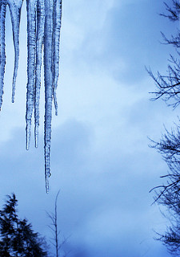
Similes make comparisons between two different things. They usually use the words ‘as’ or ‘like’ to compare.
Her fingers were as cold as ice.
Discussion
How does the simile help the reader to understand what the author means?
By comparing her fingers to something we know to be very cold – ice – we understand just how cold her fingers are!

Slide 18
Your turn: can you recognise the similes in this poem?
The Cobra
His marks are honeycomb
His eyes are like flying saucers,
His ribs stretch like elastic bands.
The curled teeth shining and ready for the victim.
His back patterns are stars in the moonlight.
Sharon Purves
Are the similes effective? How do they help the reader to understand what the author means?

Slide 19
How did you do?
The Cobra
His marks are honeycomb
His eyes are like flying saucers,
His ribs stretch like elastic bands.
The curled teeth shining and ready for the victim.
His back patterns are stars in the moonlight.
Sharon Purves

Slide 20
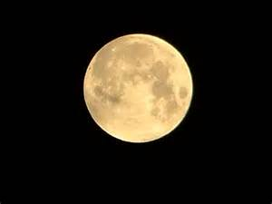
Metaphors are devices which describe something as ‘being’ something else even though it isn’t actually that ‘something else’.
The moon is a giant golf ball.
Discussion
How does the metaphor help the reader to understand what the author means?
A metaphor uses some of the characteristics which the thing being described and the metaphorical image have in common. The moon and a golf ball are both spherical, white (usually) and have a rough surface. So, by using the golf ball as a metaphor for the moon, the reader has a clear image in their mind.

Slide 21
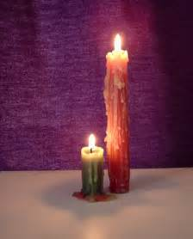
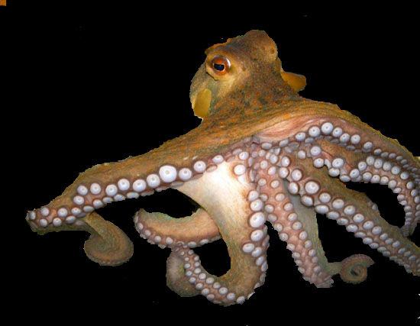
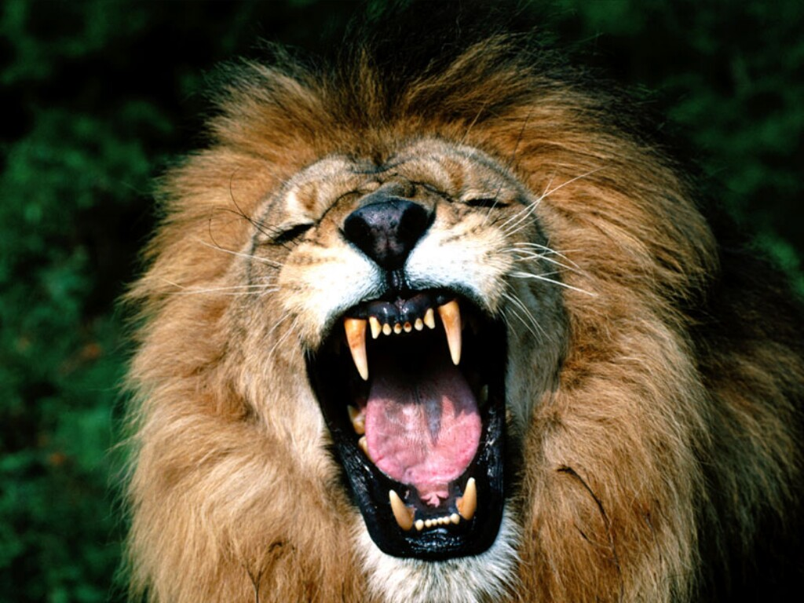
Your turn: can you link the metaphor to the object?
A multi-limbed suction device.
A tear rolled down its melting form.
Meat-tearing tools.
Your turn: can you create your own metaphor for these images?

Slide 22
Your turn: can you recognise the metaphors in this poem?
The Cobra
His marks are honeycomb
His eyes are like flying saucers,
His ribs stretch like elastic bands.
The curled teeth shining and ready for the victim.
His back patterns are stars in the moonlight.
Sharon Purves
Are the metaphors effective? How do they help the reader to understand what the author means?

Slide 23
Your turn: can you recognise the metaphors in this poem?
The Cobra
His marks are honeycomb
His eyes are like flying saucers,
His ribs stretch like elastic bands.
The curled teeth shining and ready for the victim.
His back patterns are stars in the moonlight.
Sharon Purves
Are the metaphors effective? How do they help the reader to understand what the author means?

Slide 24
Using Amazing, Awesome Alliteration!
Discussion
What is alliteration?
Alliteration is the use of the same letter in words next to or near to each other (as in the title above).

Slide 25
Why do we use alliteration?
Alliteration can focus the reader on a particular part of the text.
By repeating a letter (usually a consonant) the writer can achieve a particular effect.
The sleuth slid silently out of the window.
The repetition of the ‘s’ has a snake-like sound and makes the thief seem sneaky!

Slide 26
Your turn: can you identify the alliteration
used in this poem?
from ‘Tiger’ by Satesh Dadlani
His gleaming sharp white teeth snatch and slash at his prey.
Ears prick up and pinpoint particular sounds.
His muscular, magnificent moving tails swishes to and fro,
His golden eyes glow in the setting sun
And his massive majestic head observes everything in the forest.
Which line is the most effective? Why?
Select a line where there is alliteration. Can you improve it?

Slide 27
Personification
This is the technique where something which is inanimate (showing no sign of life) is made to appear alive.
By making something seem alive the writer hopes that the reader can connect with and picture the idea.
The gnarled branches reached out and grabbed her.
What do you think the writer wants us to think about the branches in the sentence above?

Slide 28
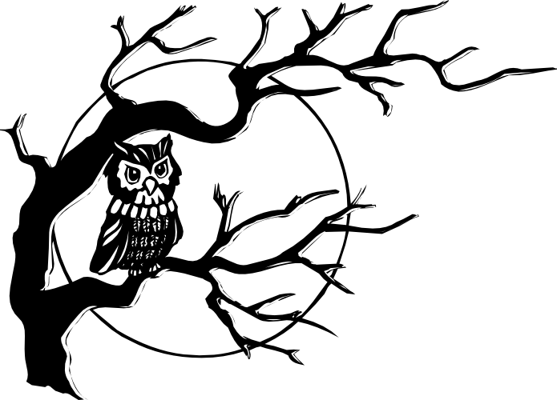
The gnarled branches reached out and grabbed her.
The branches are probably blowing in the wind but by using personification, the writer has made them seem hostile and this adds to the tension in the writing.

Slide 29
Your turn: can you identify the personification in this extract?
As the wind blew, the trees shivered and shrugged off their leaves. Dark, spiked branches reached out to grab passers by. On the ground, the rust-coloured, crinkled leaves lay like an Autumn carpet, providing an orange pathway through the woods.
As darkness fell, the huge moon winked as it peeped through the tree tops. The star-lit sky hovered as if keeping watch.

Slide 30
How did you do?
As the wind blew, the trees shivered and shrugged off their leaves. Dark, spiked branches reached out to grab passers by. On the ground, the rust-coloured, crinkled leaves lay like an Autumn carpet, providing an orange pathway through the woods.
As darkness fell, the huge moon winked as it peeped through the tree tops. The star-lit sky hovered as if keeping watch.

Slide 31
So, there are many ways to add description to texts. By using these techniques, the writer gives the reader clear images and greater detail about what is being described.
Expanded noun phrases
Adverbial phrases
Prepositional phrases
Similes
Metaphors
Alliteration
Personification
Look out for them in your reading book!

