Slide 1



B2R3c. Understands and explains the main points from what they have read, with direct reference to the text.
Commissioned by The PiXL Club Ltd.
Example 2017
This resource is strictly for the use of member schools for as long as they remain members of The PiXL Club. It may not be copied, sold nor transferred to a third party or used by the school after membership ceases. Until such time it may be freely used within the member school.
All opinions and contributions are those of the authors. The contents of this resource are not connected with nor endorsed by any other company, organisation or institution.
© Copyright The PiXL Club Limited, 2017

Slide 2
Teachers’ Notes
This therapy begins by modelling how to select key information and discard less important details. From this, the children can begin to summarise extracts in a few words. This can be done verbally or in writing.
It then moves on to using evidence from the text to support their views.

Slide 3
What is the point?
When we are reading, it is important that we can identify the MAIN POINTS from the text.
A strong wind was blowing and the leaves were falling to the ground. Up his ladder, Jim was trying to reach to clean the bathroom windows. Suddenly, he felt himself falling as a gust of wind shook the ladder.
Discussion
What is the most important point in this extract? How do you know?
The most important point is that the man was falling from the ladder. The information about the weather is the reason why he is falling but it isn’t the most important point.

Slide 4
Summarising
Summarising is a way of picking out the main points and retelling them in our own words. By doing this, we can show how well we have understood what we have read.
A strong wind was blowing and the leaves were falling to the ground. Up his ladder, Jim was trying to reach to clean the bathroom windows. Suddenly, he felt himself falling as a gust of wind shook the ladder.
If we had watched the events described in the text, and ran and told our friends, we would probably say:
The window cleaner has fallen from his ladder.
By retelling it in our own words we have:
Identified the main points.
Left out unnecessary information (like the leaves falling to the ground).

Slide 5
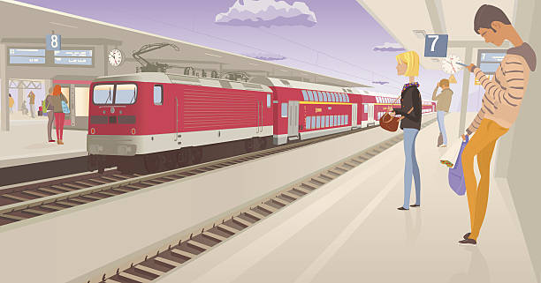
Your turn: with your partner read this extract.
Which information would you keep?
When they arrived at the train station, people were already getting on. They dashed towards the nearest door. Just as they were about to get on, Gemma dropped her favourite teddy and burst into tears. A kind man picked it up and gave it back to her. They all piled on and sat down with relief. They were on their way.
Which information would you get rid of?
Challenge – can you tell your partner what happened in fifteen words or less?

Slide 6
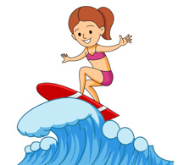
Your turn: read the following extract. Can you summarise it in two sentences (only one if you want more of a challenge)?
Ebony was nervous. It was the final round of the surfing championships. She paddled out into the sea and caught a great wave. She flew along and performed her best trick (called ‘The Snap’). A roar went up from the crowd and she knew she had won!
Remember:
Pick out the most important point.
Leave out other information.
Two-sentence summary
Ebony was competing in a surfing competition. She performed ‘The Snap’ and she won.
One-sentence summary
Ebony performed her best trick and won the competition.

Slide 7
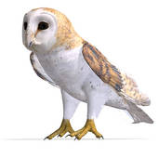
Your turn: read the following extract. Can you summarise it in two sentences (only one if you want more of a challenge)?
The Barn Owl is one of the most popular British birds. It is nocturnal, so it hunts at night. It can fly almost silently. This means it can hear the slightest sound from its prey and find them. One of the reasons that it can fly silently is the soft fringe on its feathers. This stops it from making a ‘swoosh’ sound when it flies.
Remember:
Pick out the most important point.
Leave out other information.
Two-sentence summary
Barn Owls hunt at night and fly silently. They have a special fringe to help them fly silently.
One-sentence summary
The Barn Owl can fly silently which helps it to catch its prey.

Slide 8
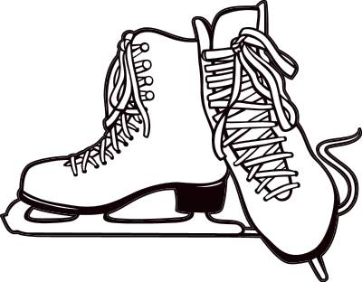
Sometimes writing will deliver a message to the reader.
Kimberley is a seven-year-old girl who has cerebral palsy. This means that she can have difficulty walking. She loves a challenge and decided to learn to ice skate. This could be quite dangerous for her. If she fell on the ice, she could hurt herself badly. But she practised every day and finally managed to go around the ice rink on her own. She received an award for bravery.
Discussion
What is the main message of this extract?
If you …
If you are determined enough, you can achieve anything.
Can you summarise it in:
15 words?
10 words?

Slide 9
So, we have practised finding the main points and summarising what we have read. We also need to EXPLAIN our answers using EVIDENCE from the text. Let’s look at the extract about Kimberley again.
How did we know what the main message was?
Kimberley is a seven-year-old girl who has cerebral palsy. This means that she can have difficulty walking. She loves a challenge and decided to learn to ice skate. This could be quite dangerous for her. If she fell on the ice, she could hurt herself badly. But she practised every day and finally managed to go around the ice rink on her own. She received an award for bravery.
The highlighted sentences explain Kimberley’s disability, so I know from this that something like ice skating would be difficult and dangerous for her.
The other highlighting picks out information which focuses on challenge and the words ‘finally managed’ make it clear that it wasn’t easy for her.
By picking out this information, I am clear that the main message of the extract is that a great deal of determination was needed to achieve this, as it was difficult and dangerous for her.

Slide 10
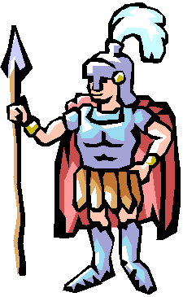
Your turn: what is the main message of this extract? Highlight EVIDENCE from the text to show how you know.
Roman soldiers spent a lot of time following orders. They were very active. They could march 30 kilometres per day wearing their armour. They would also run, swim and practise fighting. Often they were called upon to build things like bridges. Much of their time was spent marching, usually in lines. Whatever activity they did, they usually did so carrying their weapons and shield.
Read the text carefully.
What is the main message? Can you summarise it?
What is the EVIDENCE in the text that this is the main message?

Slide 11
So, when you are reading, try to think about what the main points are.
Try to practise summarising:
A paragraph.
A chapter.
A whole story.
What is the main point?
How do you know?

