Slide 1


.
Reading
Y5 R5d. Comments upon language choices/structures of different authors (particularly in poetry)
Commissioned by The PiXL Club Ltd.
November 2019
This resource is strictly for the use of member schools for as long as they remain members of The PiXL Club. It may not be copied, sold nor transferred to a third party or used by the school after membership ceases. Until such time it may be freely used within the member school.
All opinions and contributions are those of the authors. The contents of this resource are not connected with nor endorsed by any other company, organisation or institution.
PiXL Club Ltd endeavour to trace and contact copyright owners. If there are any inadvertent omissions or errors in the acknowledgements or usage, this is unintended and PiXL will remedy these on written notification.
© Copyright The PiXL Club Limited, 2019

Slide 2
Teachers’ Notes
The PiXL therapies can be taught to a whole class or a target group. Each therapy is editable so that it can be adapted or extended.
Each therapy begins with a LORIC activity to develop relevant character attributes.
This is followed by a vocabulary task, which uses the PiXL 5-phase approach to teach key vocabulary. Further resources to develop vocabulary can be found in the Whole School area under the PiXL Unlock strategy.
Each therapy adopts the ‘Teach, model and apply’ process with plenty of opportunities for pupils to demonstrate the taught skill.
A range of question types is included to promote pupils’ developing security by testing the same skill in different ways.

Slide 3

At the root of it
struct
The root ‘struct’ in structure means build. How many other words can you think of that share this root?
Vocabulary activity

Slide 4
Vocabulary choices
Writers choose their words carefully to make sure they give their readers the best possible experience. Sometimes, this can be by selecting the most appropriate word or phrase. Sometimes, it can be about their own personal style or a particular theme they enjoy writing about. Sometimes, especially in poetry, vocabulary choices help to create other effects and provide a clear structure.

Slide 5
Themes
Certain authors often return to certain themes throughout their books.
Can you match the author to the themes? Click to check.
Friendship and the triumph of good over evil.
Michael Morpurgo
People or animals caught up in warfare.
Roald Dahl
Children with difficult home lives finding success and happiness.
J K Rowling

Slide 6
Word choices
The idea of word choices covers many different aspects of writing. Usually, it involves finding the best way of describing characters or actions. This might include “writers’ tricks” such as alliteration, where words are chosen to repeat certain sounds (the big bouncing rubber ball), or onomatopoeia, where the writer chooses words that sound like the noise they are describing (bang, crash went the symbols when she dropped them down the stairs).

Slide 7
Word choices
Word choices go beyond just choosing the right verb or adjective. For example, authors also put a great deal of thought into naming their characters to give you clues about their personalities. In James and the Giant Peach by Roald Dahl, we can guess that Aunt Sponge and Aunt Spiker are not very nice. The same could be said of Draco Malfoy in J K Rowling’s Harry Potter series, whereas Dedalus Diggle is a harmless eccentric and Cornelius Fudge is a pompous, blustering politician. Meanwhile, Peter, the oldest of the four children in The Lion, The Witch and the Wardrobe, is a solid, responsible character and has a solid, responsible name.

Slide 8

Poetry
Word choices are particularly important in poetry because a poem is often about a thought or an idea rather than a story (although there are many examples of narrative poems). In fact, poetry has been described as “the best words in the best order”.
For that reason, word choices in poetry often involve a lot of figurative language such as metaphor, personification and imagery.

Slide 9
Figurative language
Metaphor – this is where words are used to represent something different in order to give a clearer meaning. For example, in The Highwayman by Alfred Noyes, the road at night is described as “a ribbon of moonlight over the purple moor.”
Personification – this uses human characteristics or behaviour to describe something that is not living. For example, in The Eagle by Alfred, Lord Tennyson describes a high crag as “close to the sun in lonely lands”. Lands can’t really feel lonely, but it gives a sense of remoteness.

Slide 10

Your turn
Read this short extract from Hope by Emily Dickinson then explain the language choices that have been used.
Hope is the thing with feathers
That perches in the soul,
And sings the tune without the words,
And never stops at all.

Slide 11
How did you do?
This is a metaphor. It gives the sense of hope being as light and cheerful as a bird.
… perches in the soul extends the bird metaphor whilst emphasising that hope comes from within.
Hope is the thing with feathers
That perches in the soul,
And sings the tune without the words,
And never stops at all.
This helps to suggest that hope is a feeling rather than a clear statement of what will be.
This line gives us the sense that there is always hope, no matter how bad things might seem.

Slide 12
Structure
Poems often have structure. This can mean they have a rhyming pattern or a certain number of syllables per line … or both … or neither! The important thing is to be able to spot and describe these structures, especially if you are able to see common themes within a particular poet’s work.

Slide 13
Structure
For example, what similarities do you notice between these two extracts of poems by Alfred, Lord Tennyson?
The wrinkled sea beneath him crawls;
He watches from his mountain walls,
And like a thunderbolt he falls.
From The Eagle
Out flew the web and floated wide;
The mirror crack'd from side to side;
'The curse is come upon me,' cried
The Lady of Shalott.
From The Lady of Shalott

Slide 14
Structure
Both poems feature lines with the same metre (structure of the rhythm) of eight syllables per line, except for the last line of The Lady of Shalott. They also both have three consecutive lines that rhyme: crawls, walls, falls and wide, side, cried.
Challenge: read the whole of both poems and describe the differences.

Slide 15
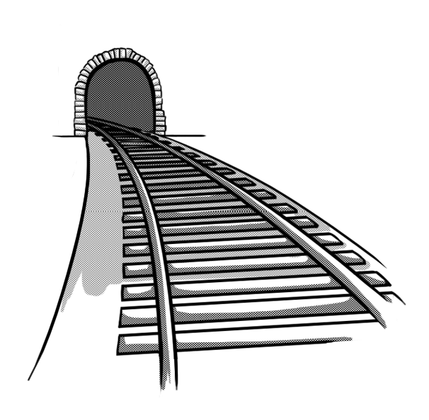
Your turn
Read this extract from a poem called From a Railway Carriage by Robert Louis Stevenson. Describe the rhyming structure and explain how the metre of the poem gives the impression of riding on a train.
Here is a cart run away in the road
Lumping along with man and load;
And here is a mill and there is a river:
Each a glimpse and gone for ever!

Slide 16
How did you do?
The metre closely resembles the rhythm of a train along the rails (clickety-clickety-clickety-clack).
The rhyming pattern consists of rhyming couplets – consecutive rhyming lines.
Here is a cart run away in the road
Lumping along with man and load;
And here is a mill and there is a river:
Each a glimpse and gone for ever!
The rhyme and rhythm structure gives the poem pace and energy.
The speed with which ideas come and go mimics the way that sights flash by when seen from a train window.

Slide 17
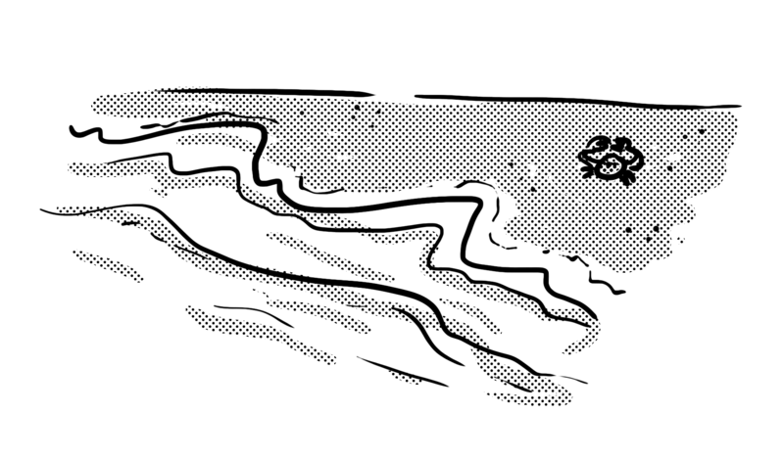
Your turn
Read this extract from The Walrus and the Carpenter by Louis Carroll. Describe the rhyming structure and any figurative language you notice.
The sun was shining on the sea,
Shining with all his might:
He did his very best to make
The billows smooth and bright —
And this was odd, because it was
The middle of the night.

Slide 18
How did you do?
Lines two, four and six rhyme with each other.
Lines one, three and five do not rhyme
The sun was shining on the sea,
Shining with all his might:
He did his very best to make
The billows smooth and bright —
And this was odd, because it was
The middle of the night.
The metre features eight beats or syllables for each odd-numbered line followed by six syllables on the even-numbered lines.
The poem uses personification to bring the sun to life: ‘Shining with all his might; He did his very best …’.

Slide 19
Review
Writers choose their words with great care and for a wide range of reasons.
Writers use a range of techniques, such as alliteration, metaphor, onomatopoeia and personification to enhance meaning.
In poetry, the vocabulary choices are particularly important.
Poems often use metre (the rhythm of the words) and rhyme to give them structure and enhance their meaning

