Slide 1
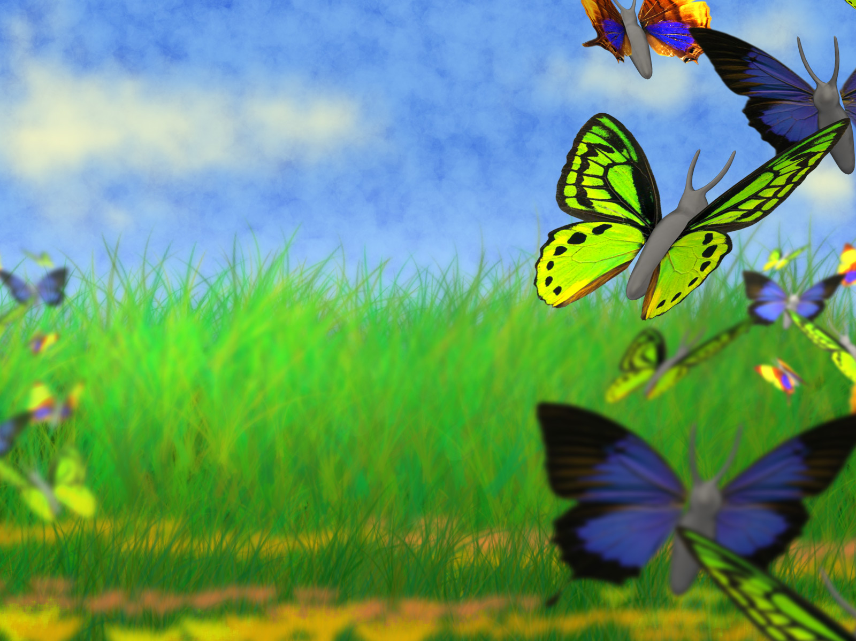
Similes

Slide 2

Simile Riddle:
Look at the answers below. What is being described in the poem?
It is as colourful as a rainbow,
Flies as high a kite,
Flutters as softly as a snow flake,
With wings like fire burning bright
A) Lion B) Onion C) Bird D) Butterfly

Slide 3





Did you get the right answer?
It is as colourful as a rainbow,
Flies as high a kite,
Flutters as softly as a snow flake,
With wings like fire burning bright
D) Butterfly

Slide 4
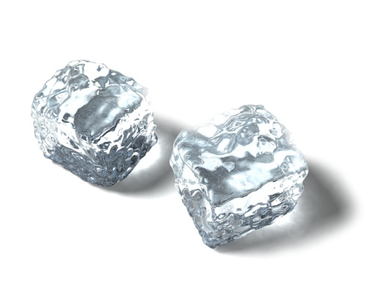
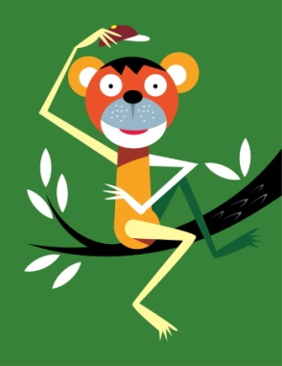
Recap: What is a simile?
A simile compares something by using the words “like” or “as”.
Example: It was as cold AS ice.
He’s cheeky LIKE a monkey!

Slide 5
Metaphors
Remember, a metaphor is a word or phrase used to describe something as if it is something else. They won’t contain the words “as” or “like.”
e.g. He was a cheeky monkey.
Her eyes were shining stars.

Slide 6
Your task: Finish these simile sentences.
The girl cried like a _______.
He was as fierce as a _________.
It was as tall as a __________.
The traffic was long like a ___________.
The teacher was singing like a _________
It was as sweet as ___________.
baby

Slide 7
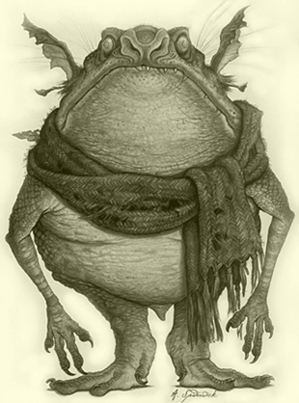
The Monster Under My Bed
There’s a monster under my bed.
He’s not scared of me, though I’m scared of him.
He’s not a very beautiful thing –
But how he loves to sing!
He looks like a bat
With ears like broccoli.
And the smell! Oh my!
He smells like my football boots
As stinky as blue cheese.
He loves to keep me awake at night by tickling me.
It makes me laugh like a monkey.
Then my mum comes to tell me off.
But I can’t tell her the truth.
There’s a monster under my bed.

Slide 8
Task 1: Complete this poem using your own similes.
The Monster Under my Bed:
My monster is as fluffy as a ______________.
He is as green as a ___________________.
He sings like a ____________________ .
The monster is as scaly as a______________.
The scary monster is old like a ____________.

Slide 9
Task 2: You need to create your own imaginary creature that you will describe in a poem tomorrow. Get creative…
What does it look like?
What does it smell like?
How does it move?
What does it do?
What does it eat?
Where does it live? (in your toilet, the shed, airing cupboard……)
Draw a picture of your creature, and start to generate some descriptive phrases to describe it.
Hint: Tomorrow, when you write your poem, I will be looking for:
Expanded noun phrases
Similes
Metaphors
Punctuation

