Slide 1


.
Reading
Y5 R5e. Confidently uses new language from their own reading experiences in their written and spoken work
Commissioned by The PiXL Club Ltd.
November 2019
This resource is strictly for the use of member schools for as long as they remain members of The PiXL Club. It may not be copied, sold nor transferred to a third party or used by the school after membership ceases. Until such time it may be freely used within the member school.
All opinions and contributions are those of the authors. The contents of this resource are not connected with nor endorsed by any other company, organisation or institution.
PiXL Club Ltd endeavour to trace and contact copyright owners. If there are any inadvertent omissions or errors in the acknowledgements or usage, this is unintended and PiXL will remedy these on written notification.
© Copyright The PiXL Club Limited, 2019

Slide 2
Teachers’ Notes
The PiXL therapies can be taught to a whole class or a target group. Each therapy is editable so that it can be adapted or extended.
Each therapy begins with a LORIC activity to develop relevant character attributes.
This is followed by a vocabulary task, which uses the PiXL 5-phase approach to teach key vocabulary. Further resources to develop vocabulary can be found in the Whole School area under the PiXL Unlock strategy.
Each therapy adopts the ‘Teach, model and apply’ process with plenty of opportunities for pupils to demonstrate the taught skill.
A range of question types is included to promote pupils’ developing security by testing the same skill in different ways.

Slide 3

Shades of meaning
Put these words in order. Explain how you have ordered them.
comfortable
reluctant
Vocabulary activity
willing
confident
able

Slide 4
Broadening your vocabulary
Why do we need to broaden our vocabulary? If you are not sure, read these two reactions to the same event. Can you guess the age of the speaker in each case?
It was nice and I liked it.
What a fabulous celebration! I was absolutely delighted to have attended such a wonderful occasion.

Slide 5

Broadening your vocabulary
You can make inferences about the ages of the speakers – most probably, you guessed that the first speaker was a young child because of the limited vocabulary.
However, acquiring new language is not about demonstrating how old or clever you are; it’s about gaining a rich variety of words with which to express yourself. The broader your vocabulary, the easier it is to make your meaning crystal clear.
Are there any words on this slide that you don’t recognise? If so, what could you do about it?

Slide 6

Be a vocabulary magpie
When you spot a word you do not recognise, or even if you’re not quite certain what it means, don’t ignore it. View it like a shiny coin that is yours to collect if you wish. Pick it up, look after it and keep it ready in case you get the chance to use it.
Magpies famously pick up shiny objects and hoard them. You could be a vocabulary magpie!

Slide 7

Use it or lose it
Of course, it’s not enough just to gather new words. You have to find out what they mean and how they are used so that you can confidently include them in your written work or what you say.
For that, you might need to check the meaning in a dictionary. Have you ever noticed that a dictionary not only tells you what the word means but also what class of word it is (noun, verb, adjective and so on) ?

Slide 8

Use it or lose it
Reading is a great way to encounter new vocabulary. Whenever you find an unfamiliar word, don’t ignore the treasure! Look it up straight away to find out what it means. If you don’t have a dictionary to hand, note down what the word is and look it up when you get the chance.

Slide 9

Finding the unfamiliar
Let’s practise. Here are the opening two lines of October by Edward Thomas. Are there any words you don’t understand? If so, look them up.
The green elm with the one great bough of gold
Lets leaves into the grass slip, one by one …

Slide 10
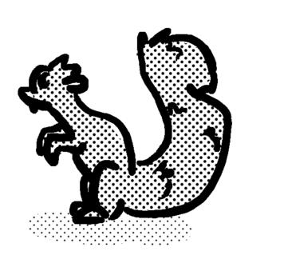
Show that you know it
Perhaps you weren’t very familiar with the word bough. A dictionary might tell you that bough is another word for the branch of a tree.
Now – and this is the really important part – we need to use it correctly in a sentence of our own.
The squirrel scampered along the thickest bough of the tree.

Slide 11
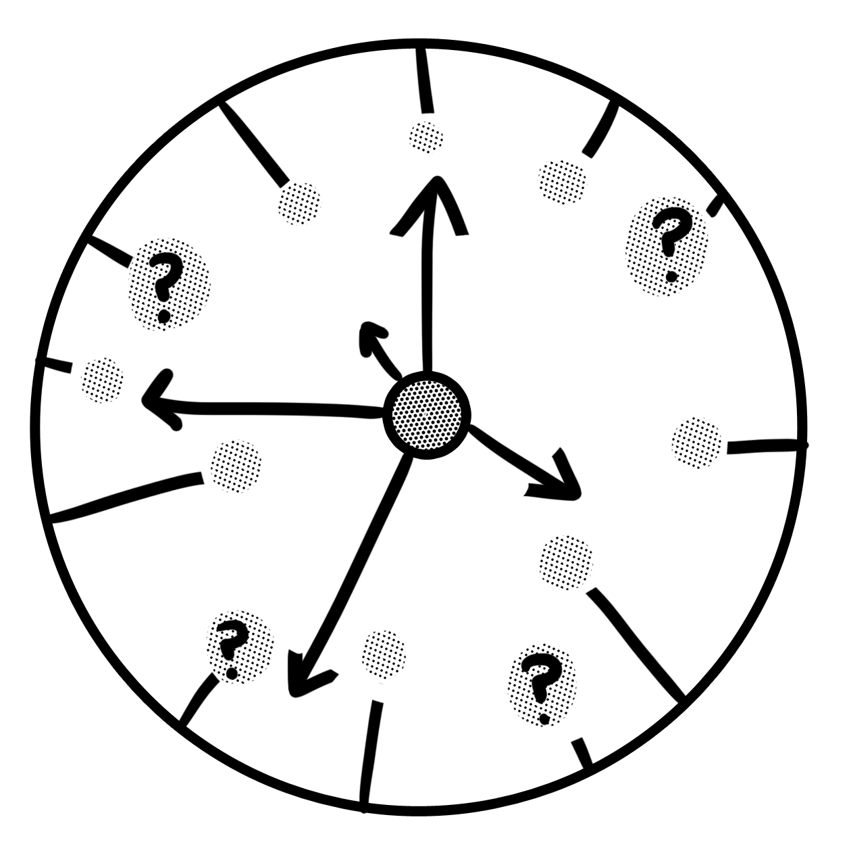
Finding the unfamiliar
Let’s have another go. Here is a sentence from The Butterfly Lion by Michael Morpurgo. Are there any words you don’t understand? If so, look them up.
The school holidays always dragged interminably
because Bertie wasn’t there on Sundays.

Slide 12
Show that you know it
Perhaps you weren’t familiar with the word interminably. A dictionary might tell you that it means endlessly or going on and on. It is often used in an exaggerated way to make a point because most things end at one time or another, even school holidays!
Now – and this is the really important part – we need to use it correctly in a sentence of our own.
The concert seemed to last interminably as the orchestra musicians scraped and banged their way through music that would have been a joy if played by anyone else.

Slide 13
Finding the unfamiliar
Let’s have another go. Here is a sentence from The Lion, the Witch and the Wardrobe by C. S. Lewis. Are there any words you don’t understand? If so, look them up.
Lucy felt a little frightened, but she felt very inquisitive
and excited as well.

Slide 14
Show that you know it
Perhaps you weren’t familiar with the word inquisitive. Even if you did know, would you be able to use it appropriately in a sentence of your own? Read the following sentences and decide which one uses it correctly. Click to check.
It was unusual to find an inquisitive this far from home.
The inquisitive hedgehog got stuck in the flower pot.
I like to inquisitive what words mean.
Perhaps you weren’t familiar with the word inquisitive. Even if you did know, would you be able to use it appropriately in a sentence of your own? Read the following sentences and decide which one uses it correctly. Click to check.
It was unusual to find an inquisitive this far from home.
The inquisitive hedgehog got stuck in the flower pot.
I like to inquisitive what words mean.
Inquisitive is an adjective that describes a desire to find things out.

Slide 15
Your turn
Read this short extract from Treasure Island by Robert Louis Stevenson. Identify a word you don’t understand or are not familiar with, look it up if necessary and use it in a sentence of your own.
I remember his breath hanging like smoke in his wake as he strode off, and the last sound I heard of him, as he turned the big rock, was a loud snort of indignation ...

Slide 16
How did you do?
You might have been unfamiliar with indignation or maybe wake. If so, here are examples of them being used in another context.
Bella was filled with indignation at having been asked to mow the lawn as well as hang the washing out.
Pasha stood by the railings at the back, watching the seagulls swooping hopefully over the ship’s churning wake.

Slide 17
Your turn
Have another go. Read this short extract from The Wolves of Willoughby Chase by Joan Aitken, then answer the questions on the following slide.
As if in contradiction of his words a sad and sinister howling now arose beyond the windows, and Sylvia, pressing her face against the dark pane, saw that they were passing through a thickly wooded region where snow lay deep on the ground.

Slide 18
Your turn
Answer these questions based on the extract on the previous slide. Click to check.
Find and copy a word that means a statement which has the opposite meaning of something someone else has said.
Which of these sentences uses the word sinister correctly?
He could tell that there was a sinister hiding in the room.
They tried to sinister the ghosts away.
A sinister, hooded figure appeared at the end of the road.

Slide 19
How did you do?
Answer these questions based on the extract on the previous slide. Click to check.
Find and copy a word that means a statement which has the opposite meaning of something someone else has said. contradiction
Which of these sentences uses the word sinister correctly?
He could tell that there was a sinister hiding in the room.
They tried to sinister the ghosts away.
A sinister, hooded figure appeared at the end of the road.

Slide 20
Review
It is important for all of us to broaden our vocabulary.
Reading is an excellent way to discover new words.
If you find an unfamiliar word when reading, look it up to find out what it means and how to use it.
Practise using new words in your own writing and conversation as soon as you can.

