Slide 1



B2R4a. Can make predictions based on knowledge of the text or similar reading experiences, giving clear reasons for their ideas.
Commissioned by The PiXL Club Ltd.
October 2017
This resource is strictly for the use of member schools for as long as they remain members of The PiXL Club. It may not be copied, sold nor transferred to a third party or used by the school after membership ceases. Until such time it may be freely used within the member school.
All opinions and contributions are those of the authors. The contents of this resource are not connected with nor endorsed by any other company, organisation or institution.
© Copyright The PiXL Club Limited, 2017

Slide 2
Teachers’ Notes
This therapy aims to model how to make a prediction based on the information provided in the text. Pupils need to understand that it can’t just be made up!
Both predicting events, or how a character may react, are based on what has already been written in the text.
The therapy models answers to prediction-type questions and provides some useful phrases for this.
It also covers how predictions can be based on typical story styles. For example, the fairy story formula is well-established. This provides a known structure for predicting what happens next. Nevertheless, this is also an opportunity to discuss the sexism inherent in this and the skill of making a story unpredictable by changing this formula!

Slide 3
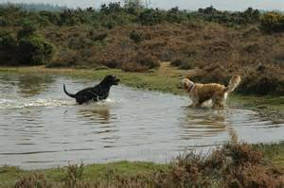
Predicting means saying what you think might happen next.
Discussion
What do you think might happen next in each picture?
Give reasons for your answer.

Slide 4
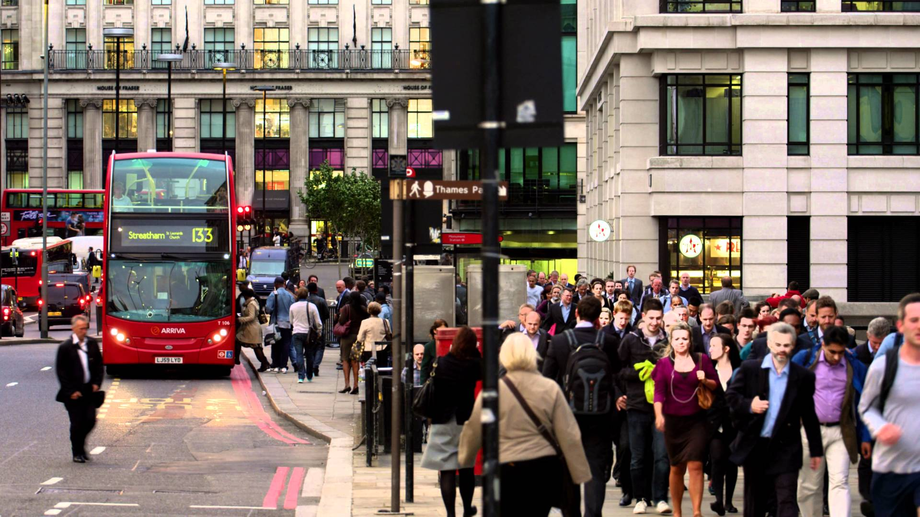
Discussion
What do you think might happen next in each picture?
Give reasons for your answer.

Slide 5
Our predictions might be based on what we have experienced before. For example, what might happen next in this sequence of events? Give reasons for your answer.
It is first thing in the morning. Some children in school uniform get into a car with their Dad. He pulls up outside their school.
My prediction is that it is likely that the children get out of the car and go into school.
My prediction is based on what I already know and on common sense. They are obviously going to school (as it is morning, they are in school uniform and he pulls up outside of school). So, it is likely that they will get out and go into school. Of course, it is not definite! Something else might happen.

Slide 6
Your turn: what might happen next in this sequence of events? Give reasons for your answer.
A man is shopping in a supermarket. He reaches up to get a box of cereals from a wobbling pile of boxes.
At a swimming pool, a person climbs up to the top diving board, balances on the edge and raises their arms.
A zoo keeper enters the sea lion enclosure with a bucket of fish.

Slide 7
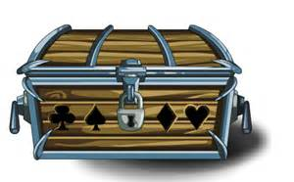
When we are predicting, there is no right or wrong answer but it needs to be logical, based on the information we have. When we are reading a text, we need to use the information in the text to support our predictions. Read this extract from a story.
“Quick. Come and look at this!” shouted Lauren to Jack (who had his nose in a history book as usual). He ran over. Lauren lifted a large, wooden box out of the ground and dumped it down. Quickly, she lifted the brown lid and peered inside. She gasped.
“What’s inside?” asked Jack, his blue eyes sparkling.
When he looked, he was amazed. Lying in a dusty heap was a ruby-red, velvet cloak. It was edged with diamonds. Gently, they lifted it out to get a better look. On the back, a golden dragon glistened in the sunshine.
“I wonder who it belonged to,” said Jack, handling it carefully. “It could be the long-lost cloak of King Erald which I was reading about. It was supposed to have gone missing in this area.”
Write down three things which might happen next.

Slide 8
How did you do? Hopefully, you thought of a few logical things which might happen.
“Quick. Come and look at this!” shouted Lauren to Jack (who had his nose in a history book as usual). He ran over. Lauren lifted a large, wooden box out of the ground and dumped it down. Quickly, she lifted the brown lid and peered inside. She gasped.
“What’s inside?” asked Jack, his blue eyes sparkling.
When he looked, he was amazed. Lying in a dusty heap was a ruby-red, velvet cloak. It was edged with diamonds. Gently, they lifted it out to get a better look. On the back, a golden dragon glistened in the sunshine.
“I wonder who it belonged to,” said Jack, handling it carefully. “It could be the long-lost cloak of King Erald which I was reading about. It was supposed to have gone missing in this area.”
Now, select what you think is most likely to happen. Give a reason for your answer.

Slide 9
How did you do?
Quick. Come and look at this!” shouted Lauren to Jack (who had his nose in a history book as usual). He ran over. Lauren lifted a large, wooden box out of the ground and dumped it down. Quickly, she lifted the brown lid and peered inside. She gasped.
“What’s inside?” asked Jack, his blue eyes sparkling.
When he looked, he was amazed. Lying in a dusty heap was a ruby-red, velvet cloak. It was edged with diamonds. Gently, they lifted it out to get a better look. On the back, a golden dragon glistened in the sunshine.
“I wonder who it belonged to,” said Jack, handling it carefully. “It could be the long-lost cloak of King Erald which I was reading about. It was supposed to have gone missing in this area.”
I think they will take the cloak to a local museum to see if the experts can help them decide who it may have belonged to.
I think this because the text mentions that Jack likes history. Also, he knows that the cloak of a king had gone missing locally.
So, my prediction might not be correct but it makes sense based on the text. I have stated what might happen then backed it up using the text.

Slide 10

So, the steps to answering prediction questions are:
Read the question.
Read the text carefully and think about what might happen next.
Find evidence in the text to support your answer.
Useful phrases for answering:
I think that …
I think this because …
In the text, it says …
The reason I think this is …
I think this because the character says …

Slide 11
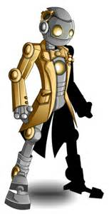
Sometimes, we need to predict how a character will behave. To do this, we have to consider what we already know about the character. Read this extract.
Zilta got out her remote and aimed it at the silver pod. Strangely, it didn’t open as usual. She tried again. Still no success. Looking up, she noticed that all of the lights were out, even though it was dark outside. Zilta felt uneasy. There had been a lot of strange things happening recently. Just that morning, she had been unable to find her hoverboard and had to walk to work.
As head of the tertia-robots, she held a powerful position in Xetton. Part of her job was to keep the city secure, so she made sure she kept fit and she was known for her quick-thinking in a crisis.
Just as she was wondering what to do, a voice from behind her boomed, “Don’t move!”
Write down three things we know about Zilta from the text.

Slide 12
Now, let’s try to use what we know about Zilta to answer a question.
Zilta got out her remote and aimed it at the silver pod. Strangely, it didn’t open as usual. She tried again. Still no success. Looking up, she noticed that all of the lights were out, even though it was dark outside. Zilta felt uneasy. There had been a lot of strange things happening recently. Just that morning, she had been unable to find her hoverboard and had to walk to work.
As head of the tertia-robots, she held a powerful position in Xetton. Part of her job was to keep the city secure so she made sure she kept fit and she was known for her quick-thinking in a crisis.
Just as she was wondering what to do, a voice from behind her boomed, “Don’t move!”
What do you think Zilta will do? Give reasons for your answer, referring to the text.

Slide 13
How did you do?
Zilta got out her remote and aimed it at the silver pod. Strangely, it didn’t open as usual. She tried again. Still no success. Looking up, she noticed that all of the lights were out, even though it was dark outside. Zilta felt uneasy. There had been a lot of strange things happening recently. Just that morning, she had been unable to find her hoverboard and had to walk to work.
As head of the tertia-robots, she held a powerful position in Xetton. Part of her job was to keep the city secure so she made sure she kept fit and she was known for her quick-thinking in a crisis.
Just as she was wondering what to do, a voice from behind her boomed, “Don’t move!”
I think Zilta will turn around to see who it is so she knows who she is dealing with. Once she has all the facts, she will make a plan and then act. She has the advantage of it being dark if she needs to run.
I think this because the text says she is quick-thinking in a crisis. This suggests that she wont panic. We also know she is fit so she would be able to run away if she needed to.

Slide 14
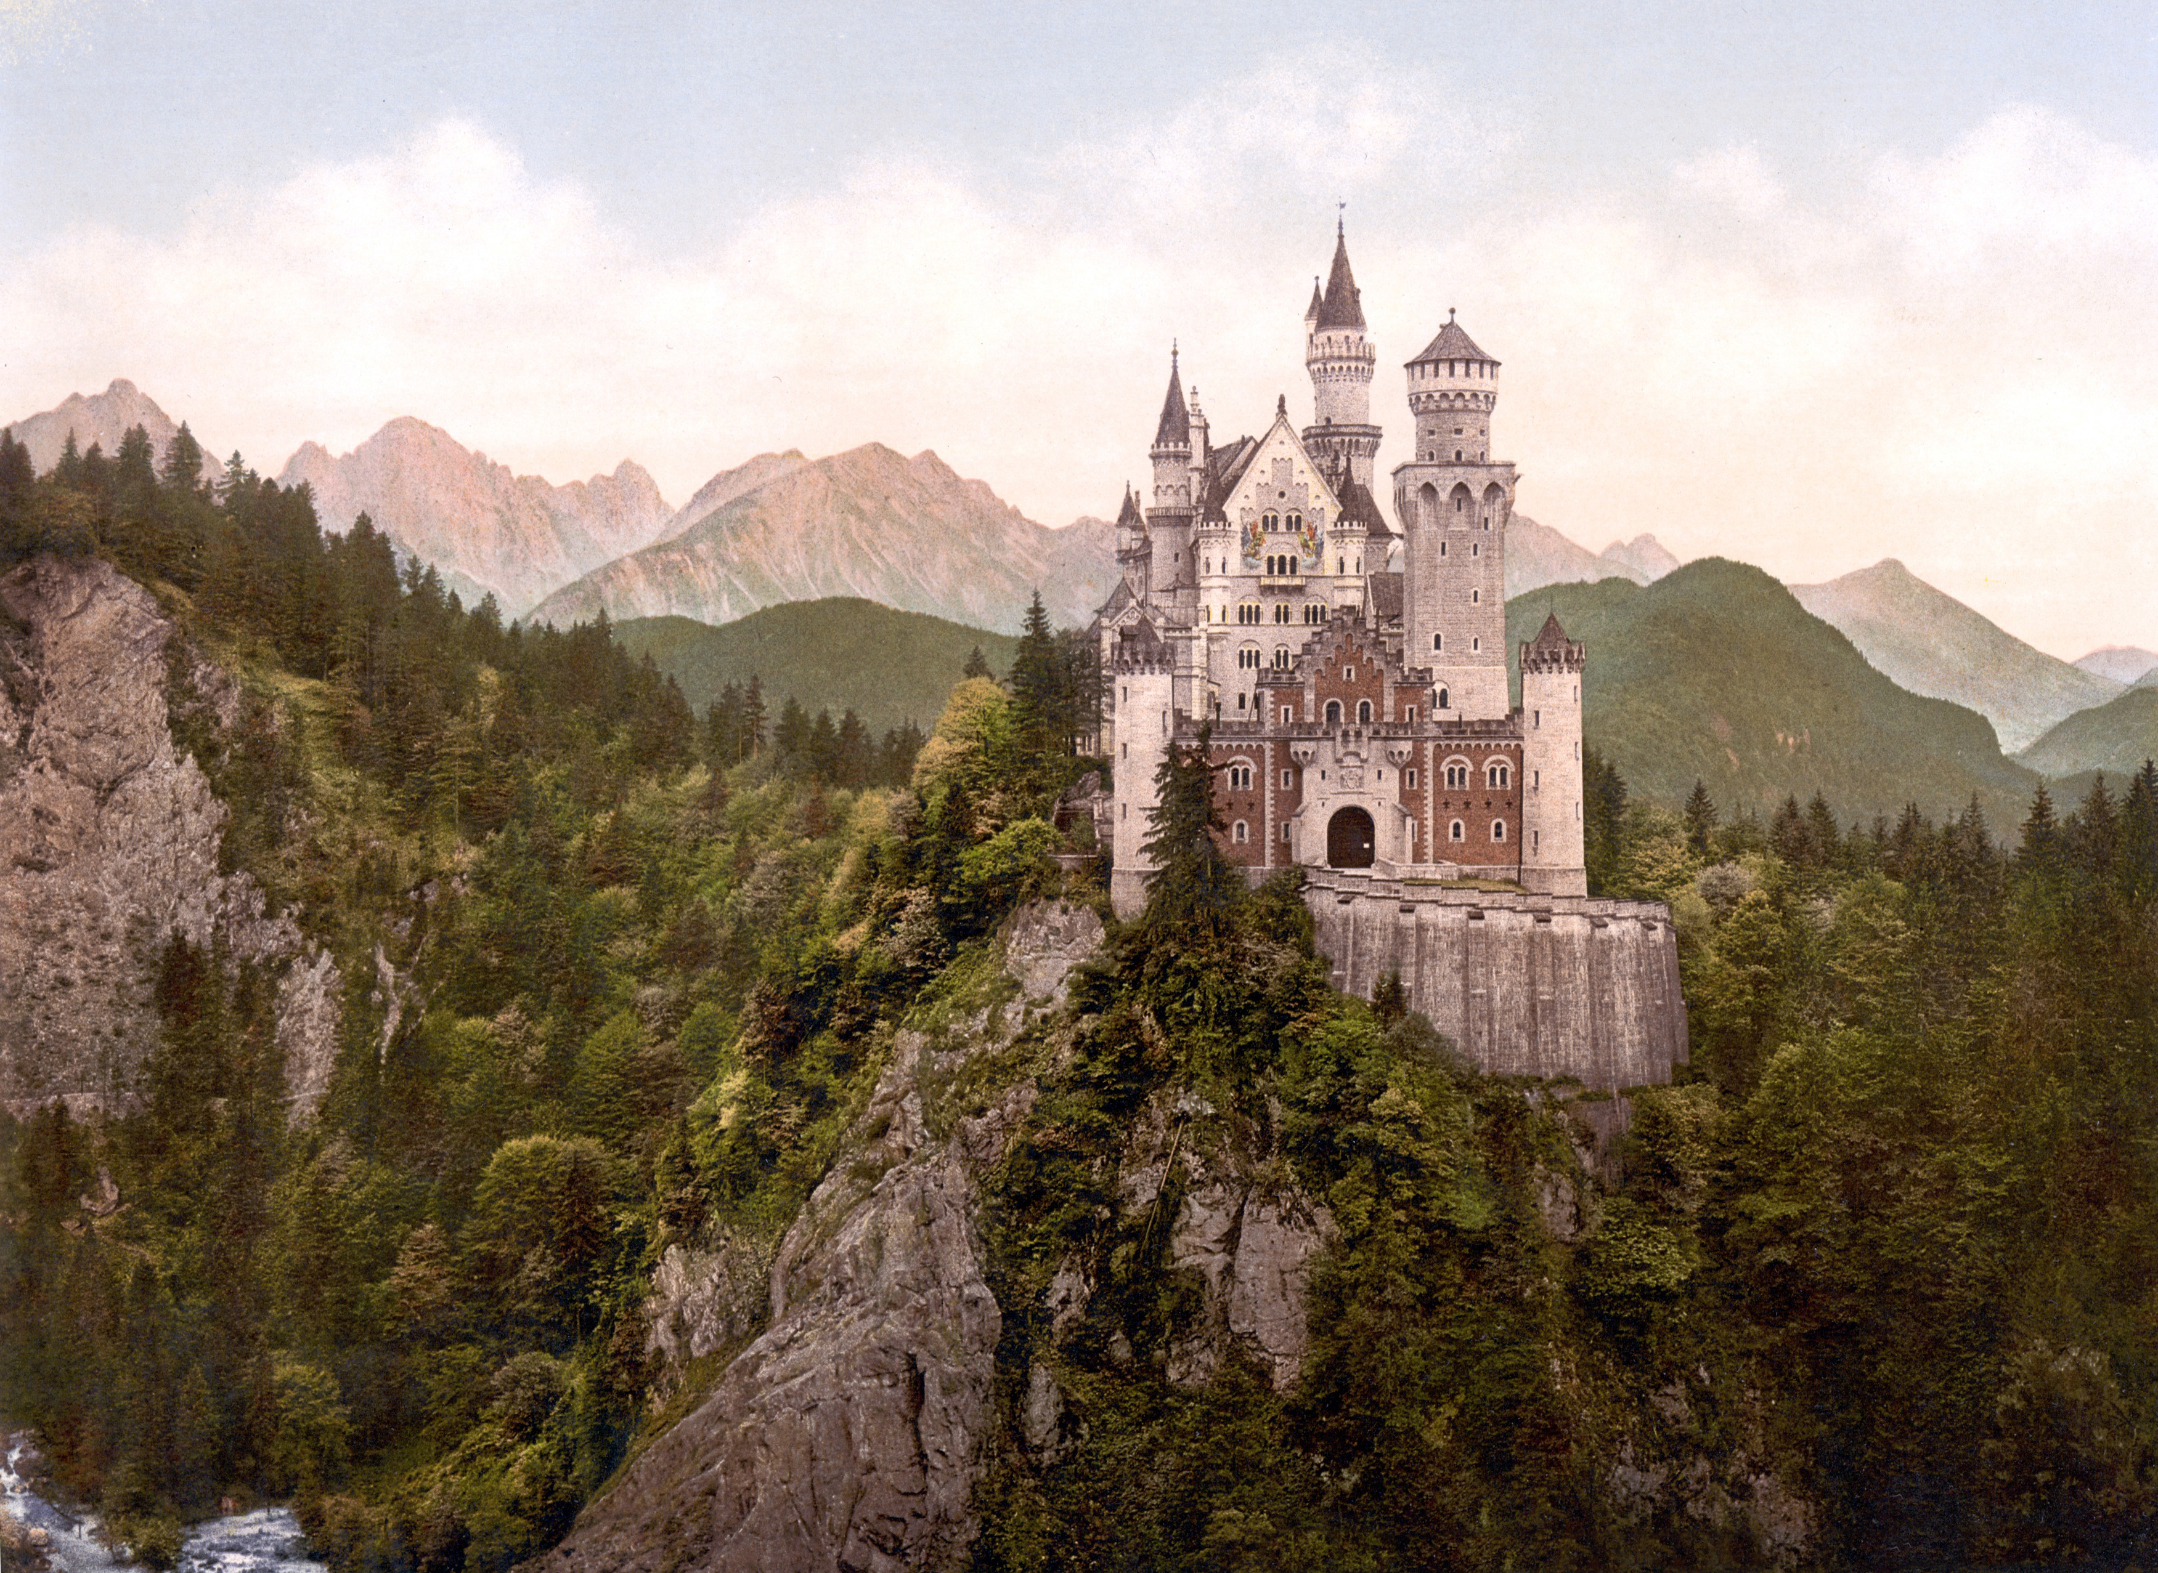
Sometimes, our predictions are based on similar stories which we have read. Some types of story follow a similar pattern.
Fairy Tales
Take place in a far-off time or place.
Typically begin ‘Once upon a time…’
Magic is part of them.
Bad kings or queens.
A girl who is badly-treated.
Unhappy people become happy.
A handsome prince rescues the girl from danger.
Good wins over evil.
Ends with ‘They all lived happily ever after.’

Slide 15
Use what you know of fairy tales to predict what might happen next.
As the princess sobbed, a tiny mouse scuttled across the dusty floor. She smiled. At least she wasn’t alone. It felt as if she had been imprisoned for weeks and she wondered if she would ever see home again. Suddenly, she heard the sound of hooves. She rushed to the tiny window and peered out hopefully.
We would probably predict that the sound of hooves is the prince coming to her rescue. We are not told this but, because we know these types of stories, it is a sensible prediction.

Slide 16
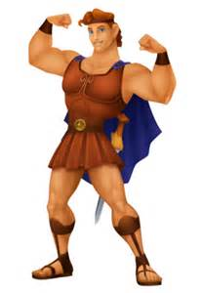
Your turn: using a typical fairy tale style, tell your partner part of a fairy story. Ask them to predict what might happen next and give reasons for their prediction.
Fairy Tales
Take place in a far-off time or place.
Typically begin ‘Once upon a time…’
Magic is part of them.
Bad kings or queens.
A girl who is badly-treated.
Unhappy people become happy.
A handsome prince rescues the girl from danger.
Good wins over evil.
Ends with ‘They all lived happily ever after.’

Slide 17
So, when you are asked to predict what happens next in a story, remember that you need to base your ideas on:
*the information in the text. or
*what you know about typical stories of its kind.
A prediction won’t necessarily be correct. The important thing is that you have backed it up with good reasons and with evidence from the text.

