Slide 1
Beatriz Milhazes

Slide 2
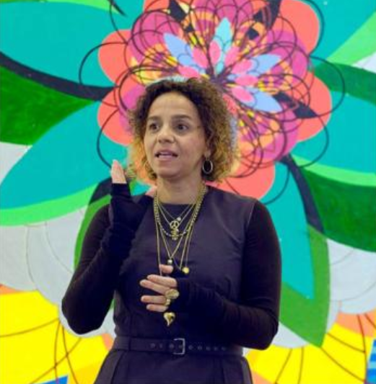
Beatriz Milhazes is a South American modernist artist, and was born in 1960. Take a look at some of her art work over the next few slides. What do you notice? How would you describe her style?

Slide 3
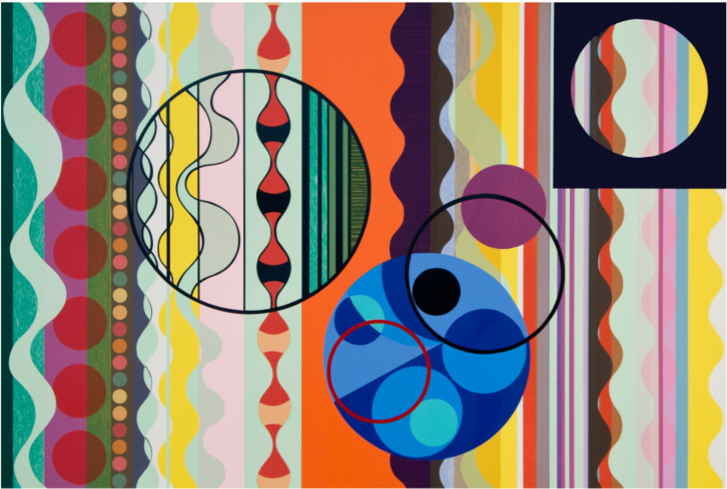

Slide 4
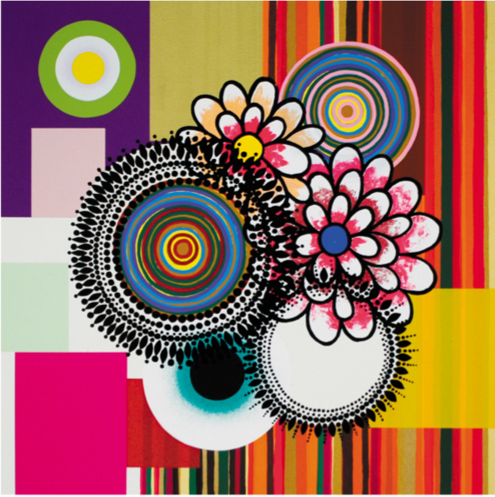

Slide 5
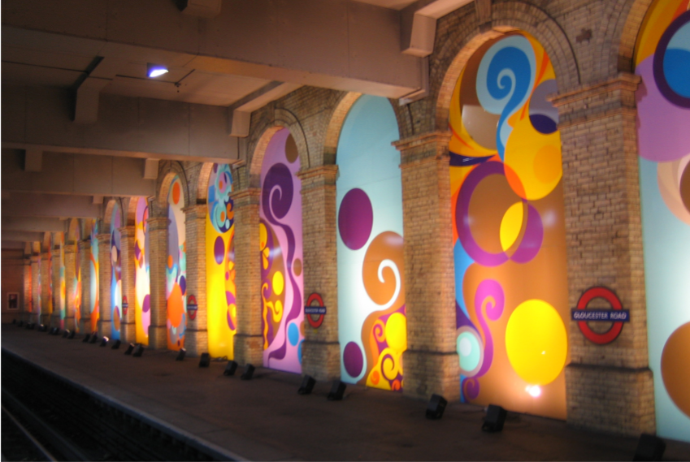

Slide 6
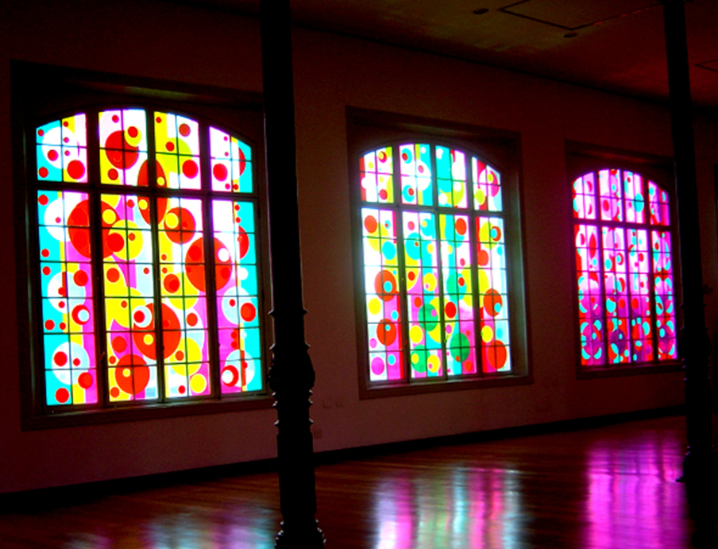

Slide 7
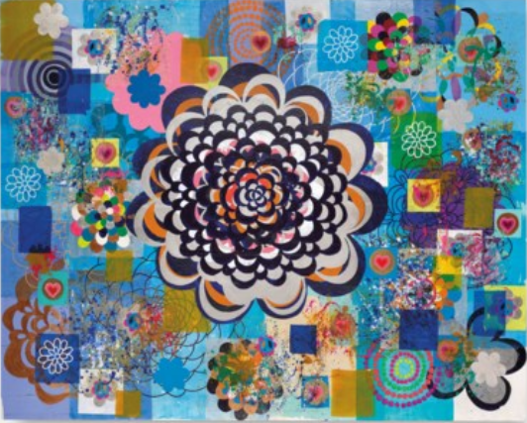

Slide 8
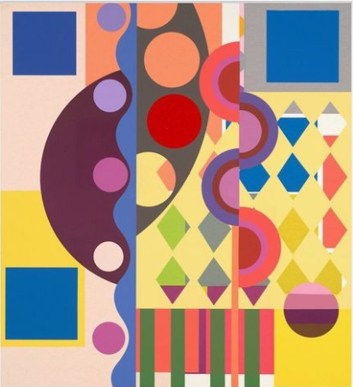

Slide 9
Your turn!
Can you create your own Milhazes inspired artwork?
You will need to think carefully about your use of shapes and colour.
You can choose which mediums to use (paint, coloured pencils, pastilles, felt tips, coloured paper) to create a bright and bold modernist painting.
I can’t wait to see some of your results!

