Slide 1
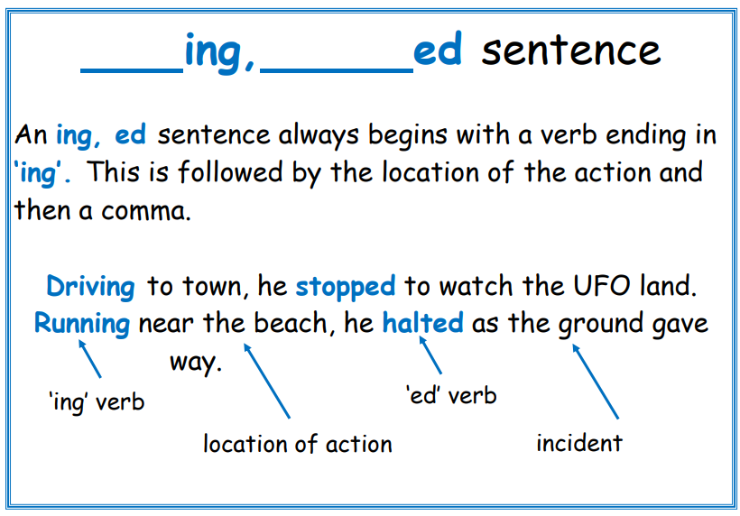
5

Slide 2

5
Try writing your own __ing, __ed sentences using this picture for inspiration.

