Slide 1
How to write instructions
This week we are learning what a good set of instructions looks like.
They must always contain –
1) ingredients or what you will need followed by a colon :
2) numbered steps in chronological order. That means in order of time.
3) Imperative verbs. These are also known as bossy verbs. They are the ‘doing words’ which command you to do something
4) adverbs
5) adjectives

Slide 2
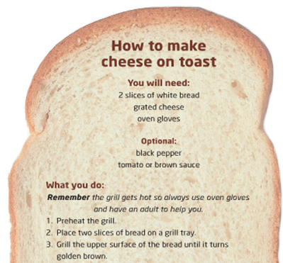
Steps in order
Colon
Can you spot the bossy imperative verbs in each step?
Where is the adjective in point 3?

Slide 3
Steps in order
Colon
That’s right the bossy verbs were: preheat
Place
Grill
Where is the adjective in point 3?
That’s right the adjectives were upper and golden .

Slide 4
Your challenge today
You have been given a set of instructions but they are in the wrong order.
The pictures are in the right order.
Look at the photos clearly to help you work out the correct order and re-write the instructions in the correct order, numbering them 1 -5 . Use your best handwriting

Slide 5


