Slide 1
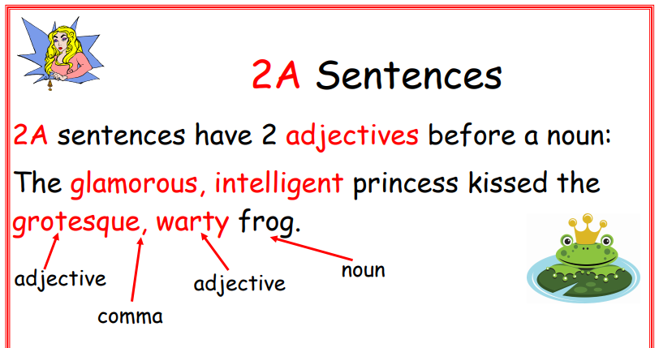
1

Slide 2
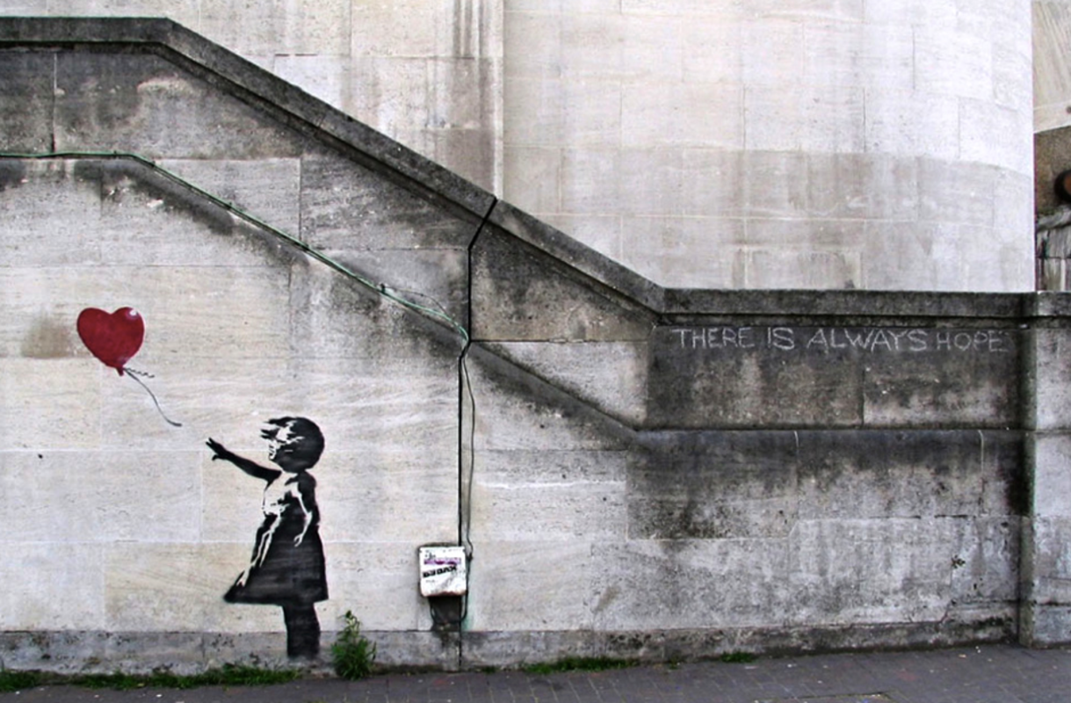
1
Have a go at creating your own 2 A sentences using this picture for inspiration.
Think:
What nouns can you see?
What adjectives can you use to describe your nouns?
Remember to punctuate your sentences accurately with:
Capital letters
Full stops
Commas between your adjectives

