Slide 1
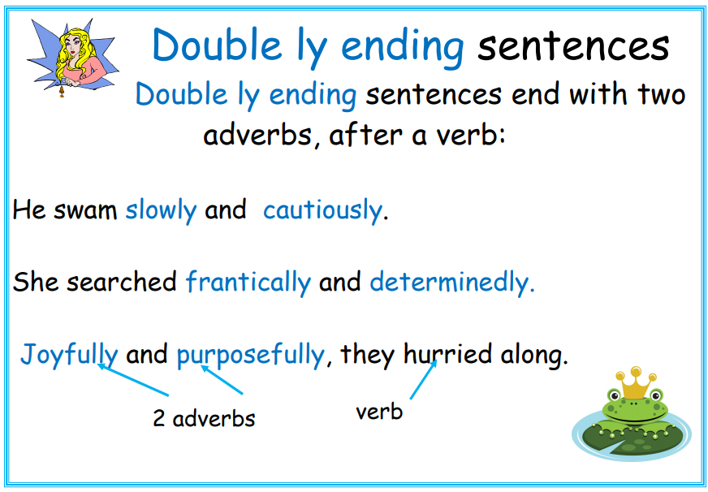

Slide 2

Try writing your own double ly sentences using the picture for inspiration.

