Slide 1
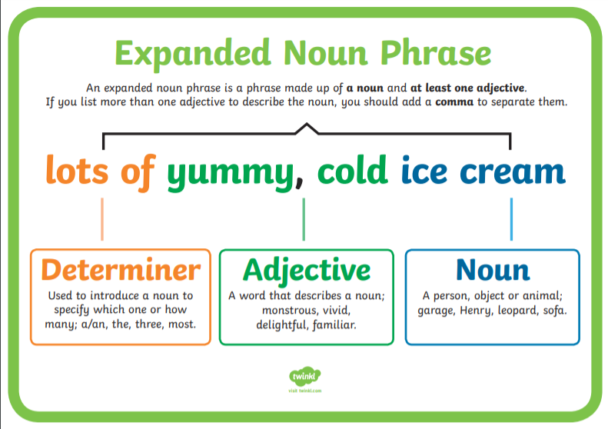

Slide 2
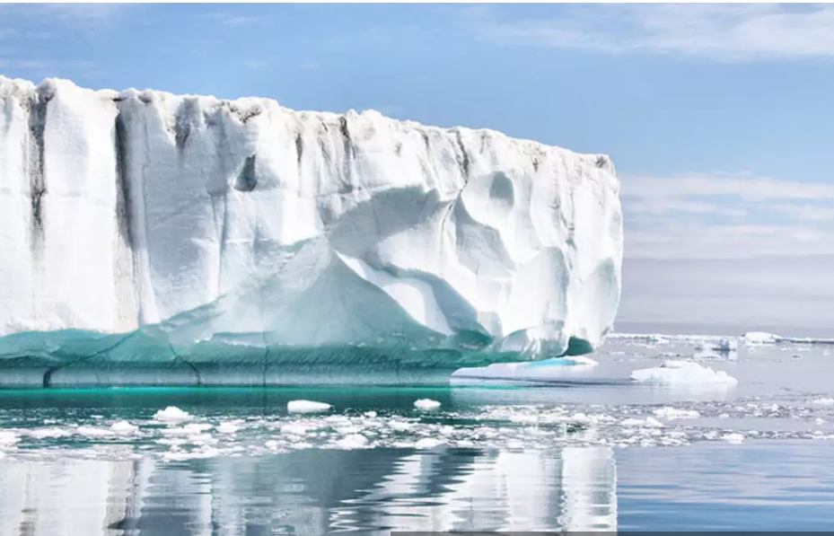
Create your own expanded noun phrases to describe the scene below. Remember to use a comma to separate the adjectives.

