Slide 1
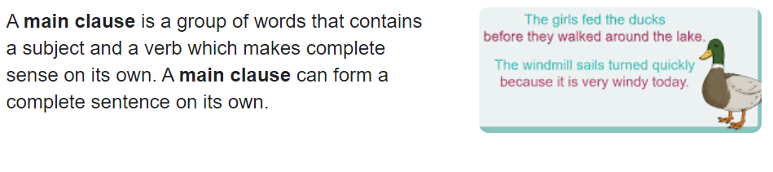
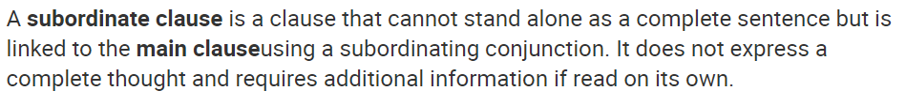
Main clauses and subordinate clauses.
Main clause: The girls fed the ducks
Subordinate clause: before they walked around the lake.

Slide 2
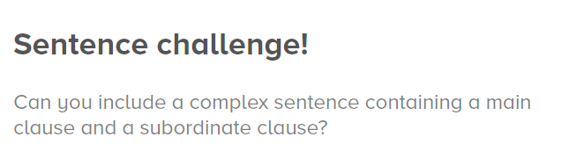
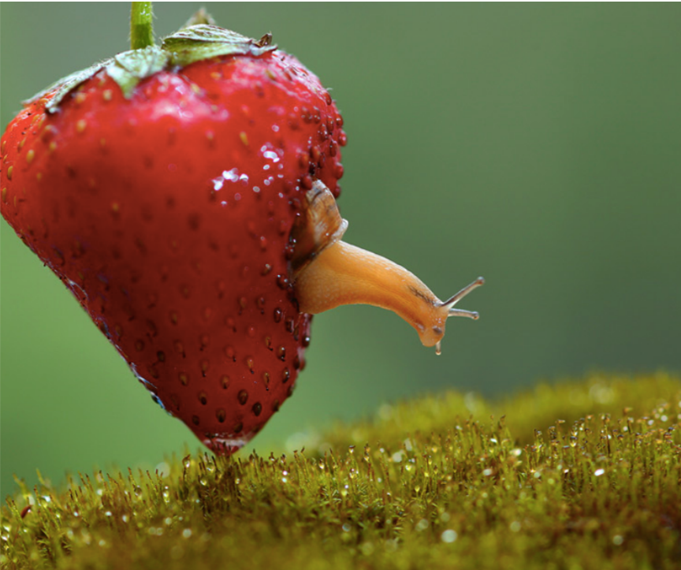
You will need to use a subordinating conjunction (see next slide for examples).
Can you vary the position of your subordinate clause? (remember to use a comma if starting your sentence with a subordinate clause).
The snail emerged slowly from the strawberry because she had eaten enough.
Because she had eaten enough, the snail emerged slowly from the strawberry.

Slide 3


