Slide 1
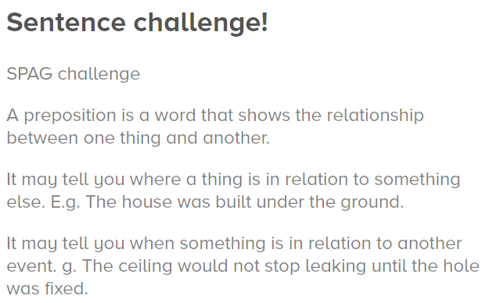
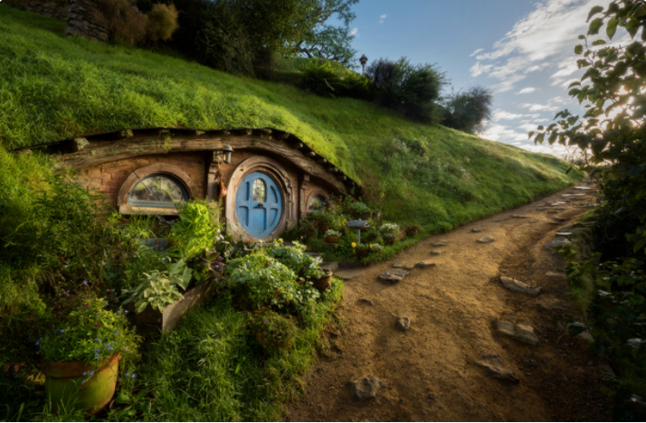
Can you write at least 3 sentences containing prepositions using the picture for inspiration?
Hint: the next slide contains a range of different prepositions.

Slide 2


