Slide 1
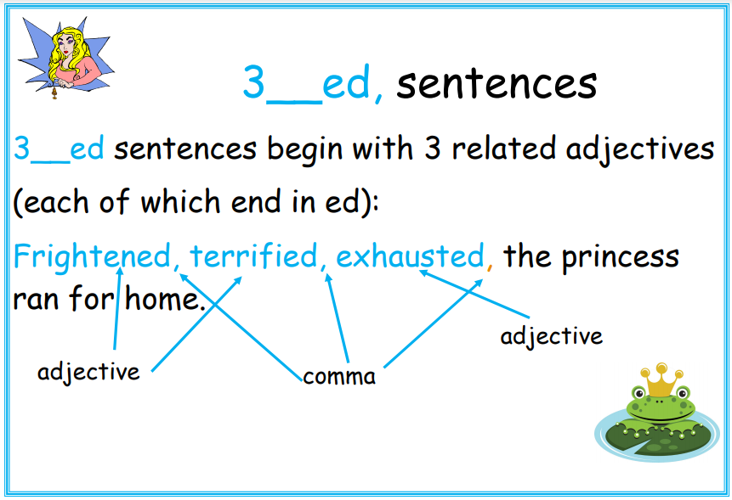

Slide 2
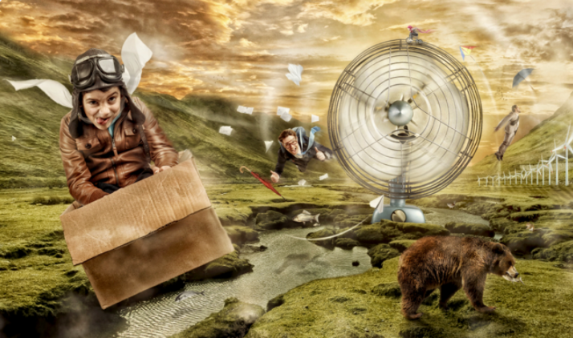
Can you write your own 3__ ed sentences using the picture for inspiration?
Try writing at least 3 different sentences by changing the adjectives you use. What impact does this have on the meaning of your sentences?
Hint: the following slide contains some ideas of adjectives ending in ed.

Slide 3
‘ed’ adjectives examples
amazed amused bored comforted
Confused depressed disappointed disgusted
embarrassed excited fascinated frightened
frustrated horrified interested irritated
puzzled relaxed satisfied shocked
surprised terrified tired worried

