Slide 1

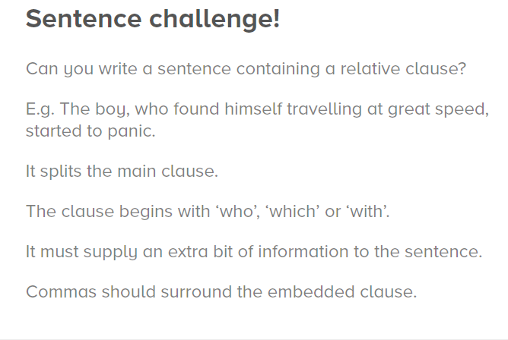
Relative clauses

