Slide 1

Mission: Create your own short story in the style of
How to Train Your Dragon by Cressida Cowell.
Use your map and setting description as a starting point to plan and then write a short, third person, past tense narrative that demonstrates your ability to develop a setting.
Task 3: Short Story
Before you write:
Revisit your map and setting description. Select the language that you will use to set the scene in your story.
Begin to consider your characters.
Who would you find in this setting?
What problem are they likely to have if they are in your setting?
Map out your story.
How will you introduce your problem/ dilemma?
How will you fix it?
What order will the events take place in?

Slide 2
Task 3: Short Story
Planning your write:
Think about stories you have enjoyed reading. What makes them interesting?
Discuss different ideas about your narrative with a friend or adult. Particularly focus on the setting, characters and problem which you have developed.
Develop your doodles and ideas into a more detailed plan using a planning frame, story map or key notes. Do not forget to use resources such as dictionaries, a thesaurus and word banks to help you – if you do not have these at home, there are versions available online.
Consider what punctuation you could use (including for direct speech) and add it to your plan.
Say out loud what you are going to write before you commit it to paper.

Slide 3
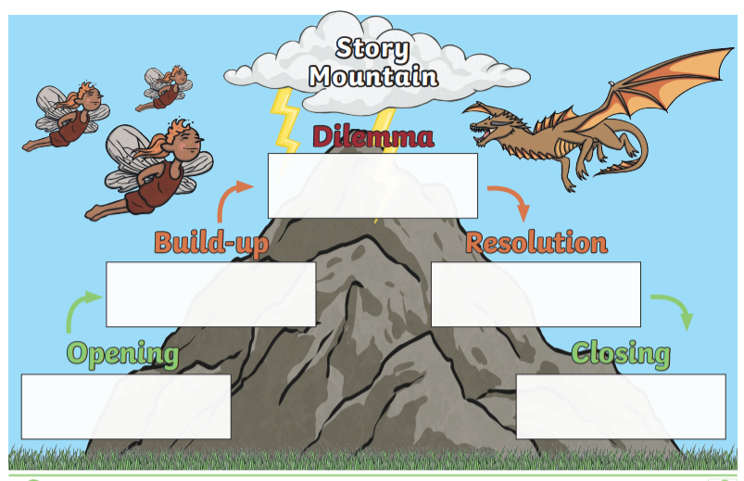

Slide 4

Task 3: Short Story
After you have written:
Read your story aloud to yourself and then a second time to a partner (if you are remote learning, this could be someone you live with or a friend on the telephone). Does the opening make them want to read on? Does your problem make the reader want to read on?
Read the whole text through. Does it flow? Does it feel like one piece of writing? If not, what could you add or move to make it feel like one piece of writing?
Look carefully at the different types of punctuation in your writing. Is it used accurately? Have you used all of the correct punctuation for direct speech?
Notice the detail you have included in your writing. What does your reader know about the main character?
Identify examples where you have chosen precise vocabulary to build up a picture for the reader. Have you experimented with the order of words in your sentences?

